Slide 1
Housing and Technology
Mrs. Blouin

Slide 2
Objectives
Evaluate the benefits and drawbacks of different natural and manufactured materials used in home construction
Describe the three basic methods of home construction
Evaluate the role of high technology in homes today

Slide 3
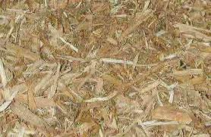
Vocabulary
Technology
Engineered wood products
Biomaterials
Green building
Site
Computer-aided design
Conventional construction
Systems-built home
Modular home
Manufactured home
Biometrics
Automated management systems

Slide 4
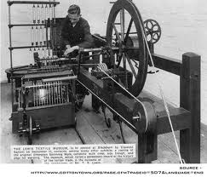
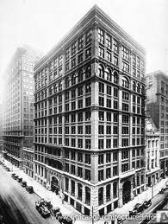
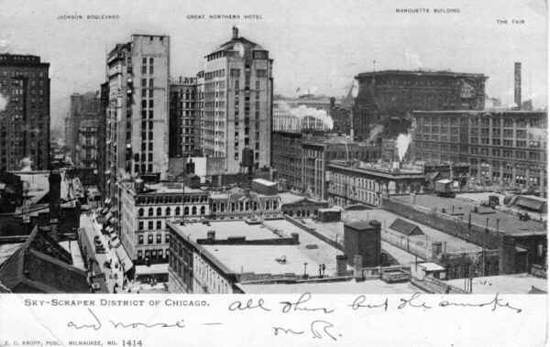
The Technology Revolution
Throughout time people have worked hard to improved the quality of life
Industrial Revolution: 1750-1900 spurred technological advances that benefited housing industry
1885 Chicago—first metal-framed skyscraper built
Technology is the practical application of knowledge—people using what they know to change their environment

Slide 5
Chicago Skyline—The Skyscraper City

Slide 6
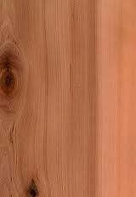
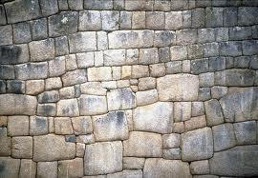
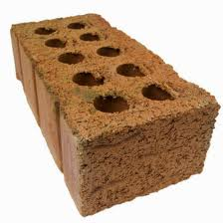
Materials and Construction Technology
For centuries, people built with locally available materials
Natural materials: wood, stone, brick
Wood: lumber—in frames, floors, woodwork, doors, other (softwood-conifer/pine; hardwood-broadleaf trees/oak/walnut/maple)
Stone: mined through a quarry, cut into large blocks (limestone, ,sandstone, marble, slate)
Brick: first made 5000 years ago, clay baked at 2200 degrees F, strong, versatile material

Slide 7
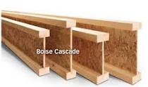
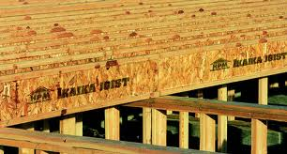
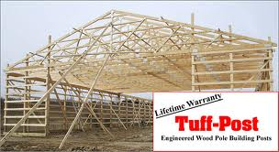
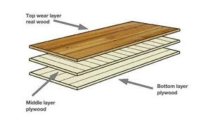
Manufactured Materials
Natural shortages (i.e.: lumber) caused “deforestation” : habitat loss for wildlife / global warming
Prompted new, innovative approaches
Engineered wood products: materials formed from wood called composite lumber (strips of wood sprayed with glue); used in beams, joists, studs, windows/door frames

Slide 8
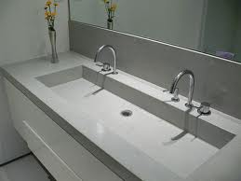
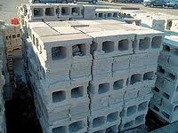
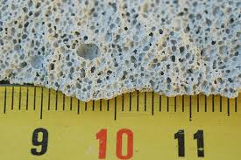
Manufactured Materials
Concrete and cement:
Concrete is a mixture of gravel, cement, and water
Its one of the oldest manufactured materials
Used by the Egyptians 3600 years ago
Concrete blocks are used today
Liquid concrete is poured into the foundation for support of the home
Also used on exterior elements: porches, patios, steps
2 x as strong as brick
Cheap, fire-resistant
New concrete: aerated with aluminum powder / expands dramatically = light weight material with better insulation

Slide 9
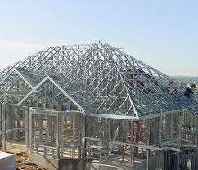
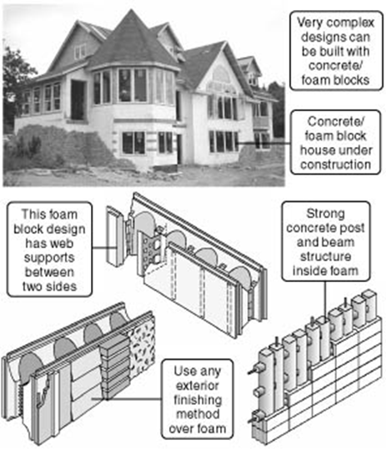
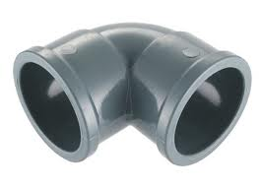
Manufactured Materials
Steel: internal frame, strong: earthquake and hurricane proof
Foam: foam blocks with steel rods, spray foam, strong / energy efficient
Plastic: not biodegradable (unkind to the planet), used in plumbing, siding and roofing, plastic “lumber” (Trex)

Slide 10
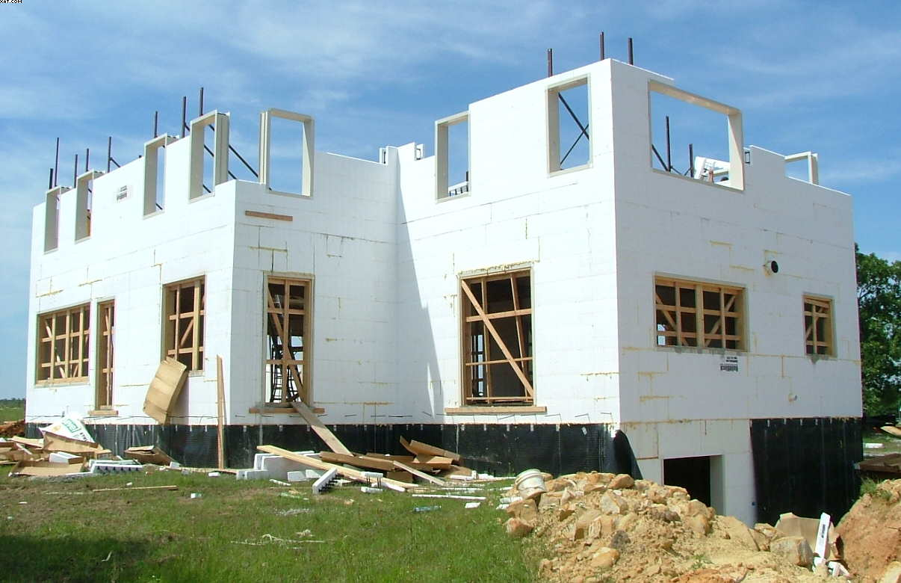
Foam block construction

Slide 11
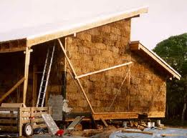
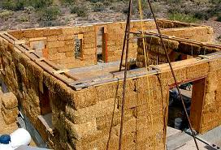
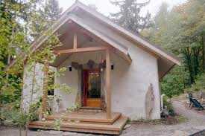
Recycled Building Materials
Recycled materials: biomaterials are organically based made from recycled matter (wheat straw, wood shavings, newspaper and plastic) used to make interior walls or decks
Last longer than wood / doesn’t warp or split
They can be customized to fit climate conditions of geographical areas

Slide 12
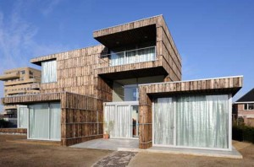
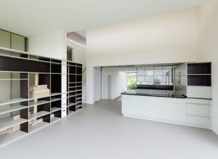
Villa Velepeloo--Amsterdam
Villa Velpeloo is a new modern home in Enschede that is about a two hour drive (or six hour bike) east of Amsterdam. The house is uber-modern and is a pleading modern design of mostly wood, glass, and steel. Its exterior is also constructed from 60% used construction materials, and the interior of the houses boasts 90% recycled content. To find old materials, the architects used new technology.
Young architects Jan Jongert and Jeroen Bergsma tackled Villa Velpeloo as their first project at the firm 2012Architecten. They reversed the typical architectural design process order by first sourcing materials and then designing the house. To find materials effectively, the architects worked together on a “harvest map,” and perused Google Earth to find possible materials within a nine mile radius of the house’s site. Brownfields, old factories, and abandoned buildings gave Bergsma and Jongert clues as to where they could find materials for their new project.
interior of Villa Velpeloo
The frame of the house is the remains of a former textile mill’s machinery. The wooden facade was layered from wooden planks, salvaged from cable reels. The home’s interior is even more creative: kitchen cabinets were repurposed from old billboards, and old umbrellas were turned into halogen lamps. Nevertheless, the interior is noted for its clean lines and broad open space, necessary for the house owners’ goal to decorate the home with their modern art collection. Their art will play off features the architects had tucked all into the Villa Velpeloo–while most of the house appears minimalist, those former billboard panels reveal themselves when the built-in cabinets are opened.

Slide 13
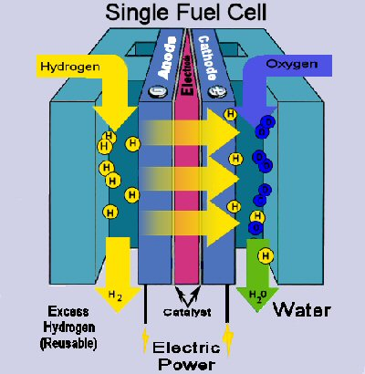
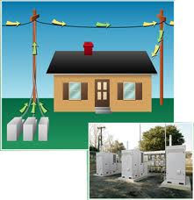
Fuel Cell Energy
Clean burning energy converted by chemical reactions into electricity
A cell consists of 2 terminals or electrodes
Under pressure, hydrogen gas is forced into one electrode and oxygen into the other
Reactions inside the cell split the hydrogen and oxygen molecules into their components including atoms and electrons
The freed hydrogen electros are channeled as an electric current where it can be harnessed to power other machines
The only byproducts are electricity, water, and heat (no pollutants)
Limitation: pure hydrogen must be extracted from other fuels like natural gas and methanol

Slide 14
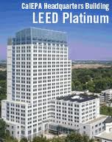
Green Building
Housing accounts for more than 20% of energy consumption
The average home produces more pollution than the average car
Housing construction, renovation, demolition creates millions of tons of waste per year
Green building is designing, building, and operating homes to use materials, energy, and water efficiently

Slide 15
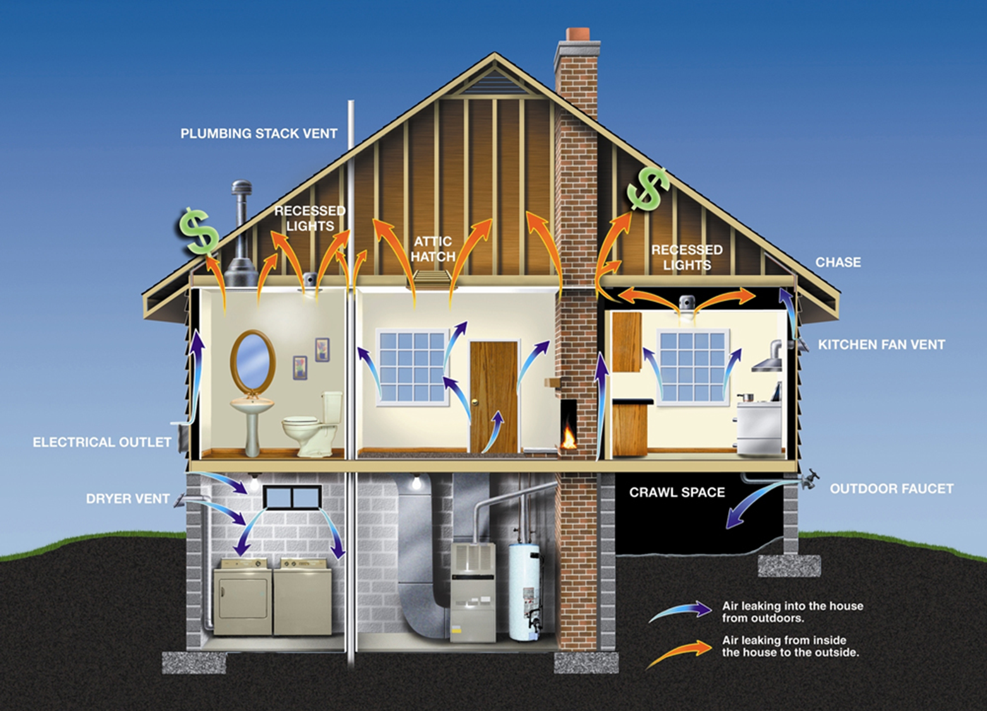

Slide 16
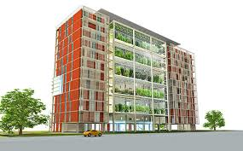
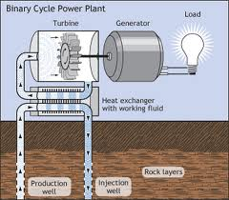
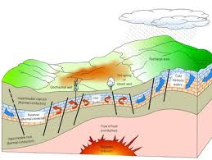
Green Building
Lower heating costs, less maintenance, healthier indoors
Use alternative energy like solar and geo-thermal heat pumps
More insulation
Energy efficient heating and cooling systems / lighting / windows / appliances
Recycled building materials
Design homes to use less materials
Partnership for Advancing Technology in Housing (PATH)

Slide 17
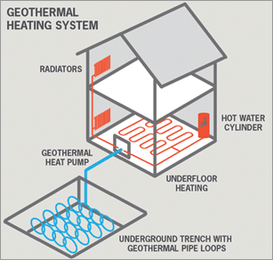
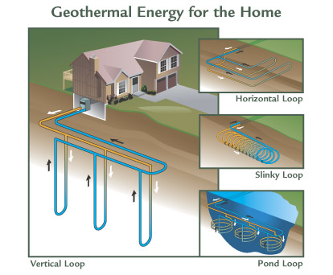
Geothermal Heating
http://energyinformative.org/geothermal-energy-pros-and-cons/
Harnessing energy using these methods can be considered non-polluting. In other words, geothermal energy is a green energy source. Using green sources of energy is crucial for fighting the climate crisis.
Geothermal heating and cooling systems can save a lot of money. It is not unusual to save up to 70% on heating bills when compared to using traditional heating systems.
Geothermal energy can be used for a wide array of different purposes. Below is an overview of the most common ones (2005).ate crisis.
Geothermal heating and cooling systems can save a lot of money. It is not unusual to save up to 70% on heating bills when compared to using traditional heating systems.
Geothermal energy can be used for a wide array of different purposes. Below is an overview of the most common ones (2005).

Slide 18
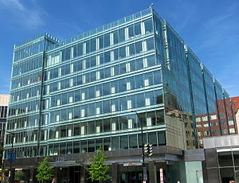
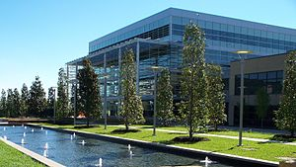
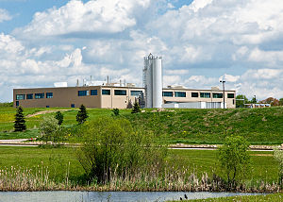
LEED
LEED is Leadership in Energy and Environmental Design;
It is a rating system for the design, construction and operation of high performance green buildings, homes and neighborhoods
LEED is a measurement tool for green building in the United States
LEED certified buildings are intended to use resources more efficiently when compared to conventional buildings simply built to code.
LEED certified buildings often provide healthier work and living environments, which contributes to higher productivity and improved employee health and comfort.
The USGBC has compiled a long list of benefits of implementing a LEED strategy, which ranges from improving air and water quality to reducing solid waste, benefiting owners, occupiers, and society as a whole

Slide 19
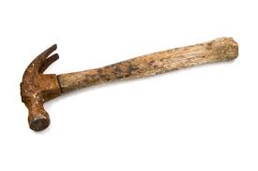
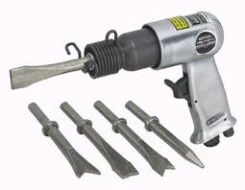
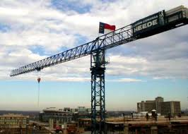
Tools and Methods of Construction
For centuries tools were simple (hammer and handsaw)
Homes were built one by one by hand
Today, new tools and methods make construction more efficient
Heavy equipment is used
Power-nailers are used instead of hammers
Things used to be done on site, now things are manufactured at factories (kitchen cabinets)
Homes can be produced in factories in sections

Slide 20
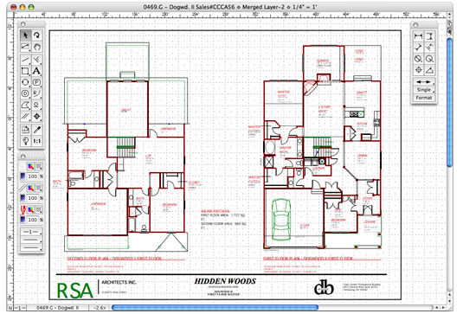
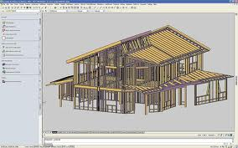
CAD
Computer-aided design programs allow designers, architects, and drafters to make construction drawings, interior designs, and other drawings using a computer
Computers help designers complete plans more quickly and easily than ever before
However, human skills will always be required for home building

Slide 21
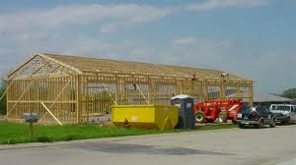
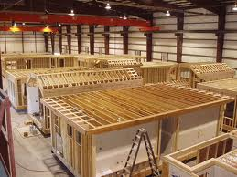
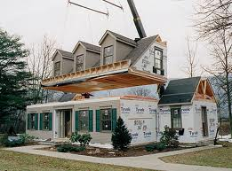
Types of Construction
Three categories: conventional construction, systems-built homes, manufactured homes
Conventional construction is when materials are cut piece by piece and assembled at the home site (stick built or site built)
Systems built home: parts are manufactured in a factory, building completed at the site (precut packages, series of panels, coordinated modules), modular homes (built as separate sections)

Slide 22
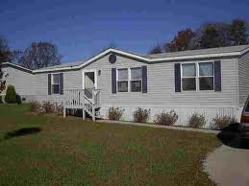
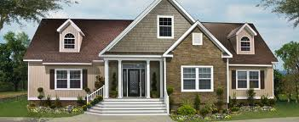
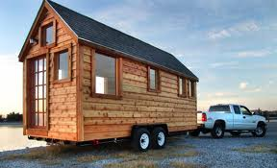
Types of Construction
Manufactured homes: completely assembled at the factory and transported to the site
Can be less expensive than conventionally built homes
The US Department of Housing and Development (HUD) has strict requirements for these homes; standards for equipment, plumbing, heating, electrical, fire safety

Slide 23
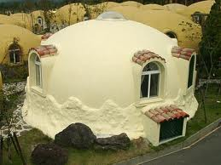
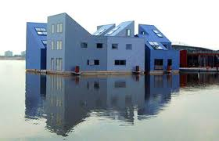
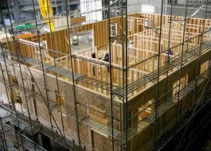
Disaster-Resistant Buildings
Hurricanes and tornadoes: reinforced concrete/foam walls; new lightweight concrete; windows with vinyl film between layers
Fire: brick and stone are best resistance; metal or concrete roofs; tempered glass
Floods: concrete, clay, ceramic floors; reinforced supporting walls, watertight doors
Earthquakes: seismic dampers—passive dampers are like shock absorbers to reduce impact, active dampers—use computers to sense movement and release energy to counteract it (need electricity)

Slide 24
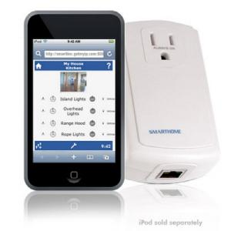
Technology in the Home
Improved appliances and heating / cooling systems
Appliances are more automated, more convenient, save more energy
What kind of “smart” appliances would you like to see developed?
Lighting: fluorescent lighting is more energy efficient, solar lighting, LED (light emitting diode) use less than ¼ of the electricity used on a fluorescent lamp

Slide 25
Technologically Advanced Home

Slide 26
Technology in the Home
Programmable heating and cooling is an automatic thermostat to adjust temperatures during the day and night; house divided into zones
Entertainment: more channels, better reception, continually changing
Communication: computer use, picture frames, electronic organizer
Security: electronic door locks, biometrics—reads the physical characteristics of a person to allow entry, motion lights, closed-circuit television

Slide 27
Where is the tech-nology in the home?

Slide 28
Check Your Understanding
Define technology and explain the role it plays in housing construction
Identify two natural building materials and describe the uses of each in home construction
What is the difference between softwood and hardwood lumber?
Identify two advantages of using brick and stone in building
What are engineered wood products? What advantages do they have over standard wood products?
What advantages does steel framing have over wood framing?
What are biomaterials made from? Give two examples of construction products made from biomaterials.
What makes green building different from conventional building?
What are three ways that technology has contributed to energy conservation in the home?
What is an automated management system? What are some of the advantages and disadvantages of building a house with such a system?

Slide 29
References:
Anderson, D., Livingston, A., Perrin, L. Venzon, C. (2007). Homes and Interiors. McGraw Hill/Glencoe. Peoria, Illinois.

