Slide 1
Early Home Styles, Home Styles since 1700, and Designing Homes for Today’s needs
Mrs. Blouin

Slide 2
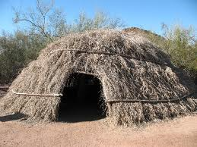
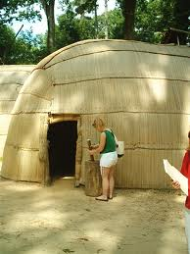
Early Home Styles
Objectives:
Describe how Native American housing was influenced by culture and environment
Explain how the early colonists created dwellings when they first came to America
Identify the materials used to build early American homes
Describe the structural feature derived from early English, German and Dutch, Spanish, Swedish, and French Homes

Slide 3
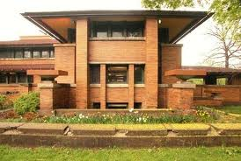
Links from the past
There is a variety of housing styles in every town
Many of the homes were designed hundreds of years ago
Many modern homes are modifications of early American styles
Technology helps designs advance
Regional differences still exist in housing

Slide 4
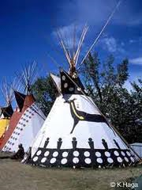
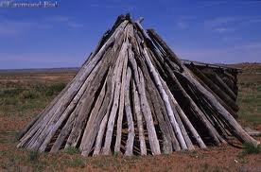
The Growth of Traditional Styles
The history of housing in North America begins with indigenous and native cultures
Native American dwellings reflected the particular tribe’s needs
The teepee is one of the most familiar styles of early Native American homes
What were some reasons this shelter was built?

Slide 5
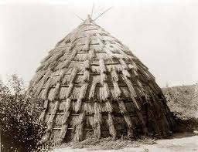
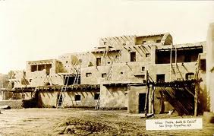
Early Native American Homes
Native people lived throughout the continent prior to European arrival
From the forests of the Northeast to the deserts of the Southwest
Each tribe developed a distinct way of life
Many depended on hunting or fishing
Some raised crops or domesticated animals

Slide 6
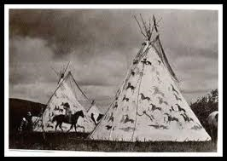
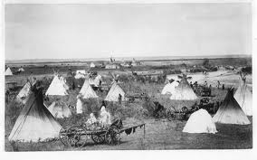
Early Native American Homes
Environment and culture were the two main influences on the type of housing developed by each tribe
Environment determined what building materials were available
Cultural considerations include: social organization, religious beliefs, food gathering, group size, family
Dwellings differed from place to place and tribe to tribe

Slide 7
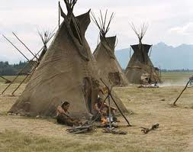
Early Native American Homes
There are common characteristics for early American Indian dwellings
Simple structures
No windows or chimneys
Cooking done over an open fire
Little furniture
Weapons, tools, possessions stored on shelves or hung from walls

Slide 8
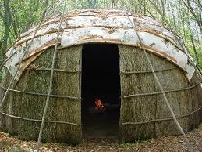
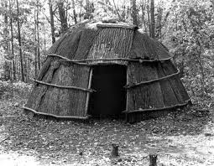
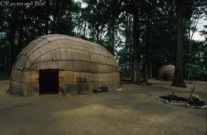
Early Native American Homes
Nomadic tribes needed portable shelters
The shelters could be moved from place to place
Eastern tribes constructed wigwams out of reed mats

Slide 9
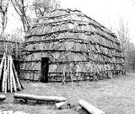
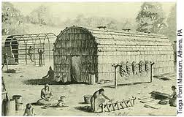
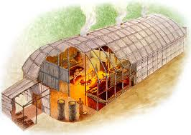
Early Native American Homes
Farming tribes established more permanent structures
Their homes lasted many seasons
The Iroquois tribes in the Northeast developed the longhouse
The longhouse was built from young trees bent to form a long rectangular frame with a barrel-shaped roof

Slide 10
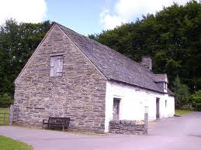
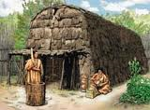
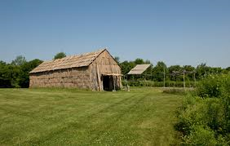
Early Native American Homes
The longhouse frame was covered with overlapping strips of bark
It housed several families
Some were 100 feet long
The first European colonists built houses similar to the longhouse

Slide 11
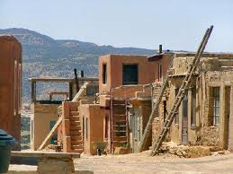
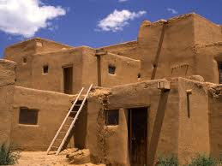
Early Native American Homes
Tribes of the Southwest built permanent structures called Pueblos
Pueblos means villages
Pueblos were houses built on top of each other into cliffs and caves on the level ground
Pueblos were built of the only material available to these tribes: clay
The clay was formed and sun-dried in to bricks called adobe

Slide 12
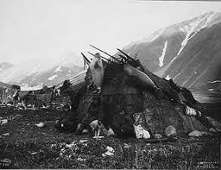
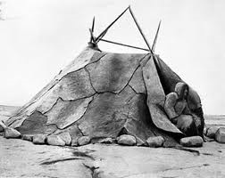
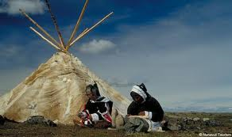
Early Native American Homes
Climates in the far north affected housing of Inuit tribes
These houses were built partially underground and covered with sod
The homes had long, downward-sloping entrances.
This kept people well-insulated
Some Inuit tribes built homes from blocks of ice

Slide 13
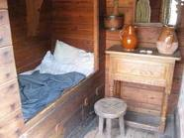
The First Colonists
They represented many groups of people
Some were seeking religious freedoms
First settlers needed to find food, clothing, and shelter
Some couldn’t make a home in the wilderness and left or disappeared
Those who survived followed the lead of Native Americans

Slide 14
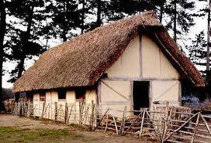
The First Colonists
They saw how native people adapted to their surrounding environment and tried to do the same
Early colonists’ shelters were huts of clay, bark, and branches or triangular, tent-like structures of logs propped together or dug-outs built into the hillside

Slide 15
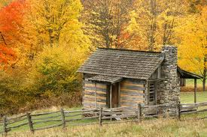
The Early American Period, 1640-1720
Many colonists’ structures were patterned after structures left behind in Europe
Modifications were made to suit weather
As more people emigrated to North American from Europe, the workforce changed
Stonemasons, carpenters were among the immigrants
Construction technology was refined

Slide 16
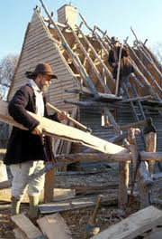
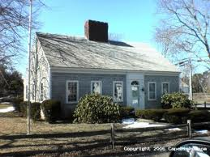
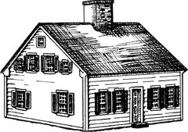
English Settlements
Jamestown, Virginia, 1607
Plymouth, Massachusetts, 1620
Half-timbered houses found in England
Thatch roofs
“Cape Cod house”—simple rectangular design, central chimney, pitched roof (gable roof—forms triangles called gables)

Slide 17
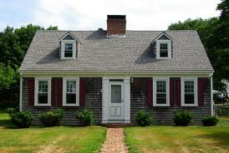
Cape Cod House
Interior was divided into one large room
One or two smaller rooms
The great room was the center of family life
Cooking, large fireplace, the only light
Everything happened by the fireplace
As families grew an “ell” or extension was built at right angles to the length of the structure
Built near the chimney/fireplace

Slide 18
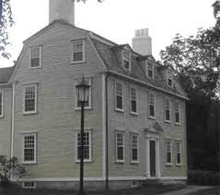
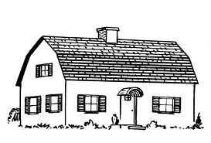
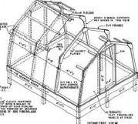
Cape Cod House
The gabled roof left little useable space on the second floor
The Gambrel Roof was developed
Two slopes on each side, the upper slope being flatter than the lower slope
Allowed for full-size upstairs

Slide 19
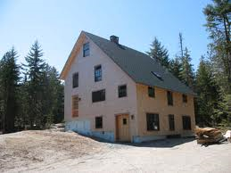
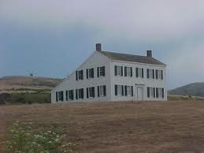
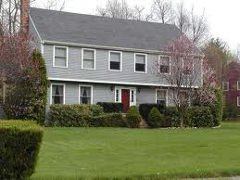
Salt Box and Garrison Homes
Salt-box homes had 2 full stories and a pitched roof
Has a long sloping back roof and central chimney
The garrison house has a second story that overhangs or projects from the first story
Garrison houses were copied from the Elizabethan homes (overhang used on forts)

Slide 20
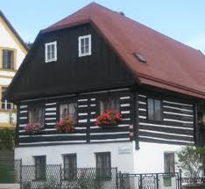
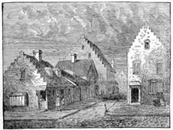
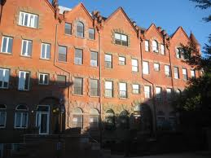
German and Dutch Settlements
German settlers came to America at the end of the 17th century in southeast Pennsylvania
Germans built large durable homes out of wood and stone
First floor kitchen
Chimney in the center of first floor
Dutch homes in New Amsterdam (New York City) used stone and brick, 4-5 stories high with fancy brick work, stepped gables

Slide 21
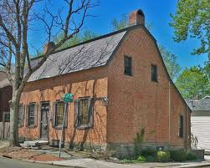
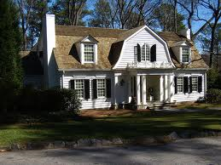
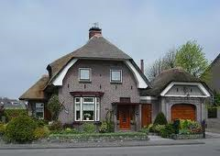
German and Dutch Settlements
Dutch homes had more useable space under the roof
The roofs had “dormers” which are windows set into the roof
Dutch homes had gutters small windows, sliding shutters, and a “Dutch door” (a door divided in half horizontally)

Slide 22
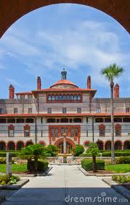
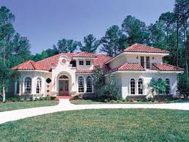
Spanish Settlements
Spaniards were the first Europeans to establish colonies in the New World
Mostly in Florida and the Southwest in the early 1500s
The oldest Spanish home is in St. Augustine, Florida, built in 1565
Its made out of “coquina” which is a soft porous limestone composed of shell and coral

Slide 23
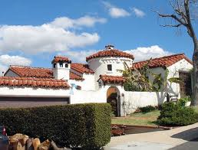
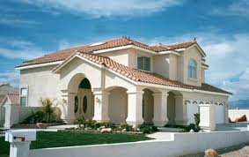
Spanish Settlements
Many Spanish style homes were rectangular, balconies faced the street
Kitchens were separate so heat from cooking wouldn’t affect the house
Interiors were simple with whitewashed plaster walls, exposed beam ceilings, and earthen floors
Tiled roofs
In the Southwest the Spaniards adopted Native styles too
They used thick adobe walls, flat roofs, rough beams, deep-set windows

Slide 24
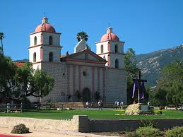
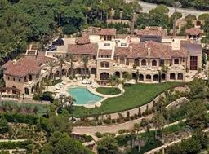
17th Century Spanish Style in California
More elaborate style created in California
Houses covered with adobe, brick or stucco
Stucco is plaster material made with cement, sand, and lime
Homes featured rounded doorways, archways, windows
Red tiled roofs
Porches and balconies went around the outside
Inner courtyards

Slide 25
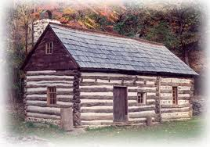
Swedish Settlements
Log cabin was most common and practical in forest areas of early America
Early settlers had to clear the land
Log cabin is part of American Folklore and is truly American style of building
Origins of log cabin are Swedish
Sweden= houses made of wood traditionally
Swedes in new world used log construction
Originally roof was bark or thatch, then later became shingle

Slide 26
French Settlements
St. Lawrence River area; stone or wood houses with steep roofs common in French country cottages
Small windows, heavy shutters (New York state, Canada)
French cottage style in Southern Mississippi Valley
Porch added because of hot, humid weather
Roof covered the porch
Houses were painted white, many doors and windows
Often built on stilts because of flooding
Found in New Orleans French Quarter

Slide 27
NOLA

Slide 28
Roots of Today’s Styles
Earliest homes were simple and practical
Early settlers follow the lead of Native Americans
Early homes were as unique and varied as the people who built them
Each culture made a contribution to the Early American period
Patterns of housing changed to meet the needs of a changing society
Housing styles are influenced by political, economic, and social factors

Slide 29
Homes since 1700
Objectives:
Evaluate how events in America’s history affect housing design
Compare and contrast housing styles in the 18th century, 19th, and 20th centuries
Evaluate historical housing elements that influenced 20th century housing
Analyze unique housing designs of the 20th and 21st centuries

Slide 30
Understanding Period Housing Styles
Architectural history is divided into various periods
Each period is influenced by historical events of the time
To identify the style of a specific house, look for the overall feeling of style
Many things break traditional rules
Examples of early architecture tend to be from people of upper or middle class

Slide 31
The 18th Century
Immigrants brought styles with them
Passed to other immigrant groups
Period and Styles | Dates
Immigrant styles | Continuous
Georgian Period/Style | 1700-1780
Federal Period | 1770-1830
Adam Style (Federal Period) | 1780-1820
Early Classical Revival (Fed.) | 1770-1830

Slide 32
The Georgian Period
Named for the Kings of England
Copied the details in England
Formal balanced design
Gable roof or hip roof
Large windows
Doorway pilasters (decorative flattened columns) topped with pediment (triangular arched décor)
Chimney at each end of house
Contrasting materials (brick and white trim)
Row houses also called town houses
Boston and Philadelphia

Slide 33
The Federal Period
1775 to 1783
After the American Revolution
Renewed patriotism, turned away from English Georgian styles
Named in honor of US government
Adam style: Americanized English type architecture
And Early Classical Revival which is an American innovation

Slide 34
Adam Style
Combined elements from classic Greece and Rome in 1780
Rectangular design with one or more stories
Gable roofs, decorative cornices
Symmetrically placed windows with fanlight (semicircular round or oval window above door)
Decorative interiors, decorative fireplace mantles

Slide 35
Early Classical Revival Style
1770 to 1830
Ancient Rome influences
Led by Thomas Jefferson (he was an architect as well as President, statesman and Inventor)
University of Virginia designs
Used for many government buildings
Federal capital in Washington DC
Rectangular shape, symmetrical windows, fanlight window, portico (tall open porch) supported by columns

Slide 36
Early Classical Revival Style- Monticello
Designed by Thomas Jefferson

Slide 37
The 19th Century
Industrial Revolution during 1800s
Many immigrants
Railroads
Construction industry developing at rapid pace
Apartments common in cities
Tenements (apartments with minimum standards of sanitation, safety and comfort built)
Some Americans very wealthy, some very poor
Multi-family homes common and crowded
Housing styles were changing

Slide 38
The 19th Century
Periods and Styles | Time Frames
Romantic Revival Period | 1820-1880
Greek Revival Style | 1825-1860
Revival Style | 1840-1880
Italianate Style | 1840-1885
Victorian Period | 1860-1900
Mansard Style | 1860-1880
Queen Anne Style | 1870-1890

Slide 39
Greek Revival Style
Part of the Romantic Revival period
1825-1860
Southern Plantation style
Links to ancient Greek temples
2 story porch
2 story rectangular house, symmetrical windows
Gable roof with wide trim
Pilasters on corners
Elaborate entrance
Columns supporting porch

Slide 40
Gothic Revival Style
1840-1880
European features like pointed arches, circular windows
Built out of wood (less expensive)
High-peaked Gothic gables and gingerbread trim (lacy looking wood cutouts)

Slide 41
Italianate Style
Italian villas, 1840-1855
Square with 2 stories
Wide overhanging hip-roofs and brackets/supports at cornices
Long narrow windows

Slide 42
Mansard Style
In the Victorian Period
Second Empire style
French influence
1860-1880
Boxlike mansard roof
Mansard roof has two slopes on all sides; lowest slope steep, highest slope almost flat
Decorated cornices, French windows

Slide 43
Roof Designs

Slide 44
Queen Anne Style
1870s-1880s
Most fanciful of Victorian styles
Irregular steep roof with ornamental gables
Overlapping wood shingles
Wraparound porches
Circular tower
Spindle work

Slide 45
The Early 20th Century
One of the most creative and productive times in history of home design
Architects took bold steps in new directions
One was based on traditional styles
One was based on new and modern ideas

Slide 46
The Early 20th Century
Period Styles | Dates
Colonial Revival Style | 1880-1955
Tudor Style | 1890-1940
Chateau-esque Style | 1880-1910
Mission Style | 1890-1920
Modern Styles: Prairie Style | 1900-1920
Craftsman Style | 1905-1930
International Style | 1925-present

Slide 47
Colonial Revival Style
1880-1955
Duplicated styles from America’s past
Brought back Georgian, Saltbox, and Cape Cod style
Door and windows have a decorative pediment with pilasters
Pediment extends forward, symmetrical façade, prominent entrance

Slide 48
Tudor Style
1890-1940
half-timbered look
Steeply pitched gab les
Tall narrow windows
Massive decorative chimneys
Stucco, brick and stone

Slide 49
Chateau-esque Style
French palaces provided the model
Towers, turrets, ornamental metal cresting, elaborate moldings, relief carvings, arched windows and doorways
Castle like structures
Grand look
Wealthy Americans built them

Slide 50
Mission Style
1890-1920
Southwestern US
Inspired by California’s Hispanic heritage
Fashioned after old mission churches
Arched doorways, tile roofs, parapets, exterior walls of stucco
Bell towers, turrets
Pyramid shaped roofs

Slide 51
Prairie Style
Beginning of 20th century Frank Lloyd Wright began designing Prairie style homes
Most Prairie style homes were built around 1920
Wright’s homes are characterized by their emphasis on horizontal lines, low-pitched roofs with over-hanging eaves, wide porches, and such details as leaded glass windows

Slide 52
Prairie Style
The interior of these homes feature rooms that flow from one room to another, creating a feeling of spaciousness
The rooms are open and connect with the outdoors
Porches and terraces help draw the outdoors inside
Prairie style influenced many homes in the 1920s
Most common forms are square, two story houses with a hip roof
Also called the American Foursquare

Slide 53
Craftsman Style
Originated in southern California at the same time as Prairie style and share many characteristics
Is distinguished by the “bungalow” (small one story home with an overhanging roof and covered porch)
A variation is the 1 ½ story type
Bungalows met the need of a smaller less expensive home

Slide 54
Craftsman Style
Was adapted across the US until 1930
Has a low-pitched gable roof (or hip roof)
Decorative beams or braces under the eaves
Full or partial width porches with the roof supported by columns or pedestals extending to the ground

Slide 55
Modern Craftsman Style

Slide 56
International Style
After end of WWI, European architects began to experiment with new building materials
The result was International style, also called Modernism or Functionalism
Le Corbusier of Switzerland was one of the designers
Walter Groupius of Germany
Ludwig Miles va der Rohe of Germany
Emphasis on function and usefulness
Steel construction, roof flat, asymmetrical design, resembles sculpture
Exterior walls smooth, blank surfaces, large windows

Slide 57
International Style—Denver, CO

Slide 58
Postwar Modern Styles
Ranch Style: long, low, one-story, low-pitched gable, dominated styles in the 1950’s
Contemporary Style: 1950-1970, wide eave overhangs, low-pitched roofs, integrates landscape around it, strongly influenced by Craftsman and Prairie homes

Slide 59
Postwar Modern Styles
Split-level Style: bi-level, tri-level, 1950’s popular, modification to ranch style, took advantage of a sloping lot
Shed Style: 1960s, steeply pitched shed roofs, sloping different angles

Slide 60
Unique Designs
A-Frame: gabled roof goes to the ground, vacation homes, ease in building, odd interior can be harder to decorate
Geodesic Dome: in 1947 R. Buckminister Fuller invented the home, triangular frames join to form roof and walls, self supporting and interior walls are not needed

Slide 61
Designing homes for today’s needs
Communities must be planned
Zoning laws (laws determine the type of building in a section of the community) must be followed
Building codes (rules that regulate quality of materials and construction) must be followed
Aesthetic codes (regulate the appearance of buildings) must be followed
Neighborhoods have to be planned around schools, open areas, shopping, roads, ponds, pathways

Slide 62
Designing homes for today’s needs
Reflects changes in our society
Social trends affect housing
Green systems and construction
Functional interiors: plan for traffic and private zones, service zones, and social areas
Think about floor plans: open or closed?
Consider the culture, the client’s needs, and the societal trends

Slide 63
Designing Culturally Sensitive Housing

Slide 64
References
Anderson, D., Livingston, A., Perrin, L. Venzon, C. (2007). Homes and Interiors. McGraw Hill/Glencoe. Peoria, Illinois.

