Slide 1
S | P | I | C | E
Problem
Situation
Construct
Evaluation
Investigation

Slide 2
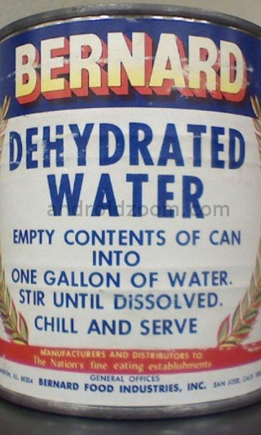
Situation
The situation should be open-ended enough to allow for a wide variety of solutions to the problem and should be as realistic as possible.

Slide 3
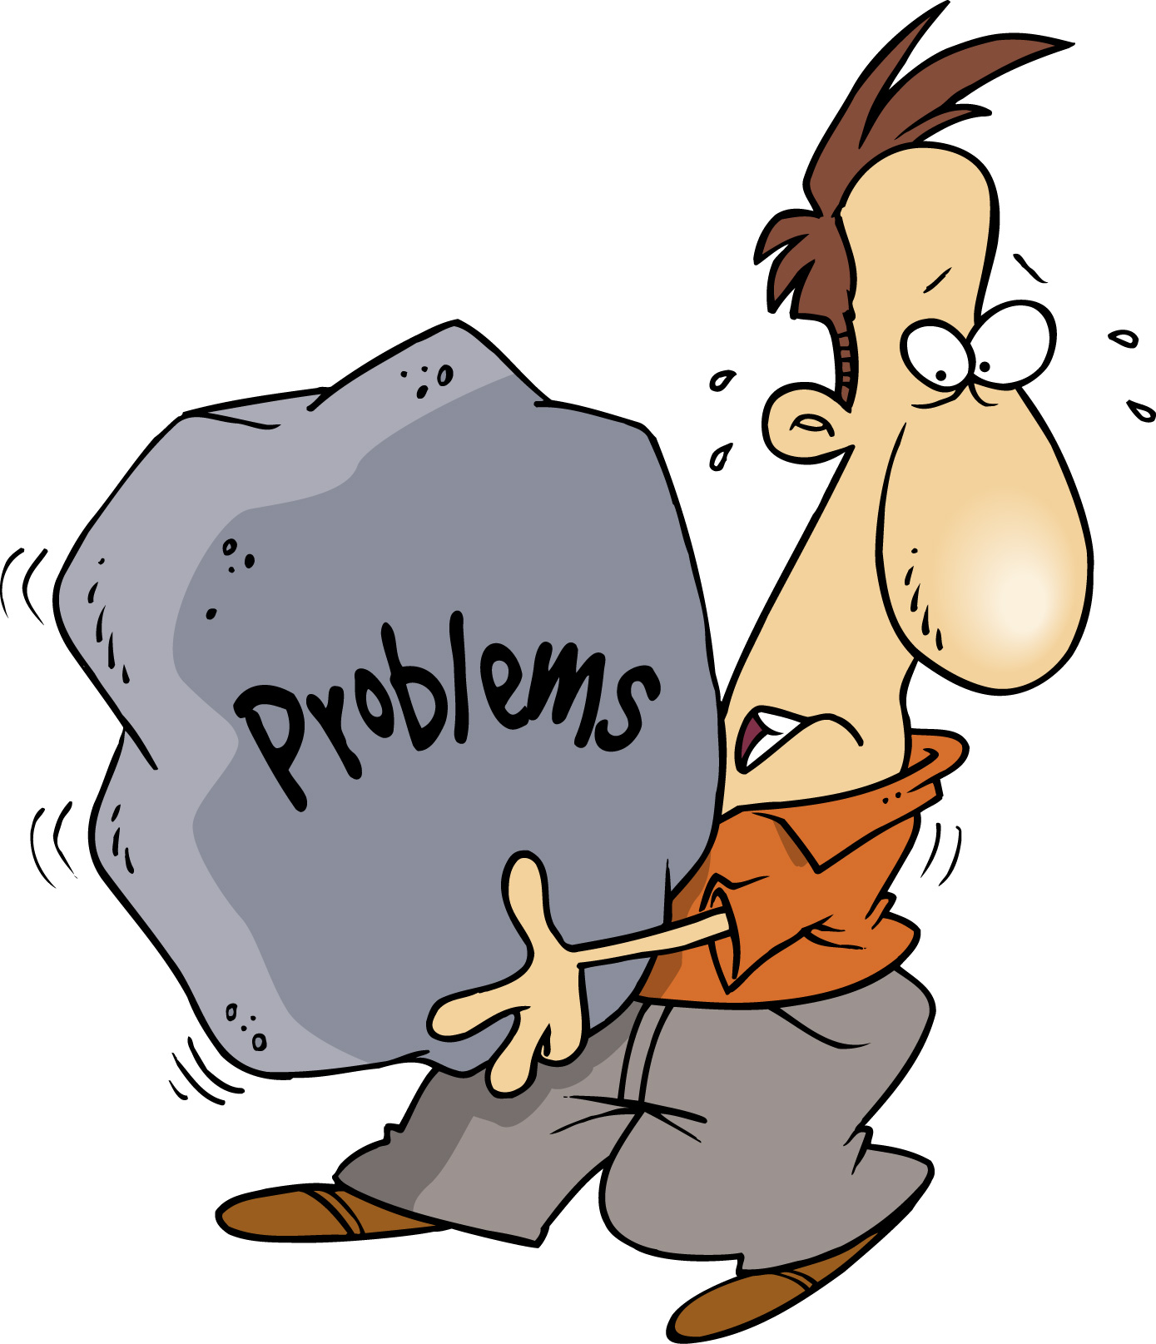
Problem
Once students understand the situation presented, they are encouraged to pinpoint a resolvable Problem or possibility.

Slide 4
Investigation
During this stage of the design process, students consider any requirements dictated by the problem.

Slide 5
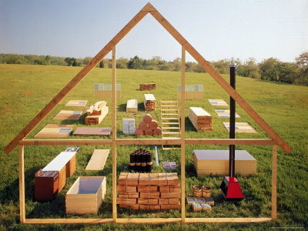
Construction
This is the stage of the process in which students take one of the ideas generated during their investigation and produce their product

Slide 6
Evaluation
The problem is tested to see if it really solves the initial problem. The intent of the evaluation is to provide a reflective activity for a student that shows them the degree of success and the compromises they made.

