Slide 1
Chapter 1 Orthographic Projection
Basic Topics
Advanced Topics
Exercises

Slide 2
Ortho. Projection: Basic Topics
1.1) Engineering Graphics Overview
Summary
1.2) Orthographic Projection
1.3) The Glass Box Method
1.4) The Standard Views
1.5) Lines Used in an Orthographic Projection
1.6) Rules for Line Creation and Use
1.7) Creating an Orthographic Projection

Slide 3
Ortho. Proj.: Advanced Topics
1.8) Auxiliary Views

Slide 4
Ortho. Projection: Exercises
Exercise 1-1: Principle views
Exercise 1-2: Line types
Exercise 1-3: Line use in an orthographic projection
Exercise 1-4: Missing lines 1
Exercise 1-5: Missing lines 2
Exercise 1-8: Drawing an orthographic projection 1
Exercise 1-9: Drawing an orthographic projection 2

Slide 5
Ortho. Projection: Exercises
Exercise 1-12: Auxiliary views

Slide 6
Engineering Graphics
1.1) Introduction to Engineering Graphics

Slide 7
Engineering Graphics
What is Engineering Graphics?
What is an Engineering Drawing?
A set of rules and guidelines that help you create an Engineering Drawing.
A drawing that communicates an idea or design.

Slide 8
Engineering Graphics
Examples of Engineering Drawings
Mechanical Engineers
Detailed drawing of a part that needs to be machined.
Electrical Engineers
A circuit schematic.
Circuit board layout.
Civil Engineers
Plans for a bridge.
Road layout.

Slide 9
Orthographic Projection
Summary

Slide 10
Summary
What will we learn in Chapter 1?
How to create an orthographic projection.
Key points
An orthographic projection is a 2-D representation of a 3-D object.

Slide 11
Orthographic Projection
1.2) Orthographic Projection Introduction

Slide 12
Introduction
Orthographic projection = 2-D representation of a 3-D object.

Slide 13
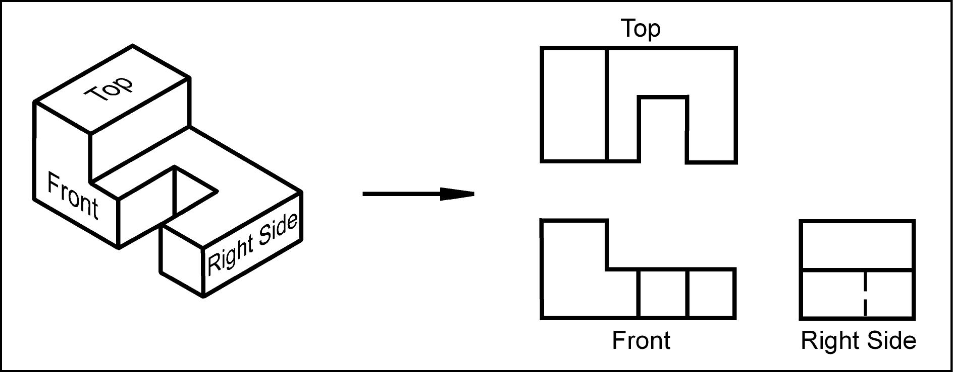
Introduction
An orthographic projection represents different sides of an object.

Slide 14
The Six Principal Views
The 6 principal views are created by looking at the object, straight on, in the directions indicated.

Slide 15
Orthographic Projection
1.3) The Glass Box Method

Slide 16
The Glass Box Method
How do we create the 6 principal views?
The Glass Box Method

Slide 17
Glass Box Method
The object is placed in a glass box.
The sides of the box represent the 6 principal planes.

Slide 18
Glass Box Method
The image of the object is projected on the sides of the box.

Slide 19
Glass Box Method
Things to notice!
The projection planes.
The projectors.
How surfaces A and B are projected.

Slide 20
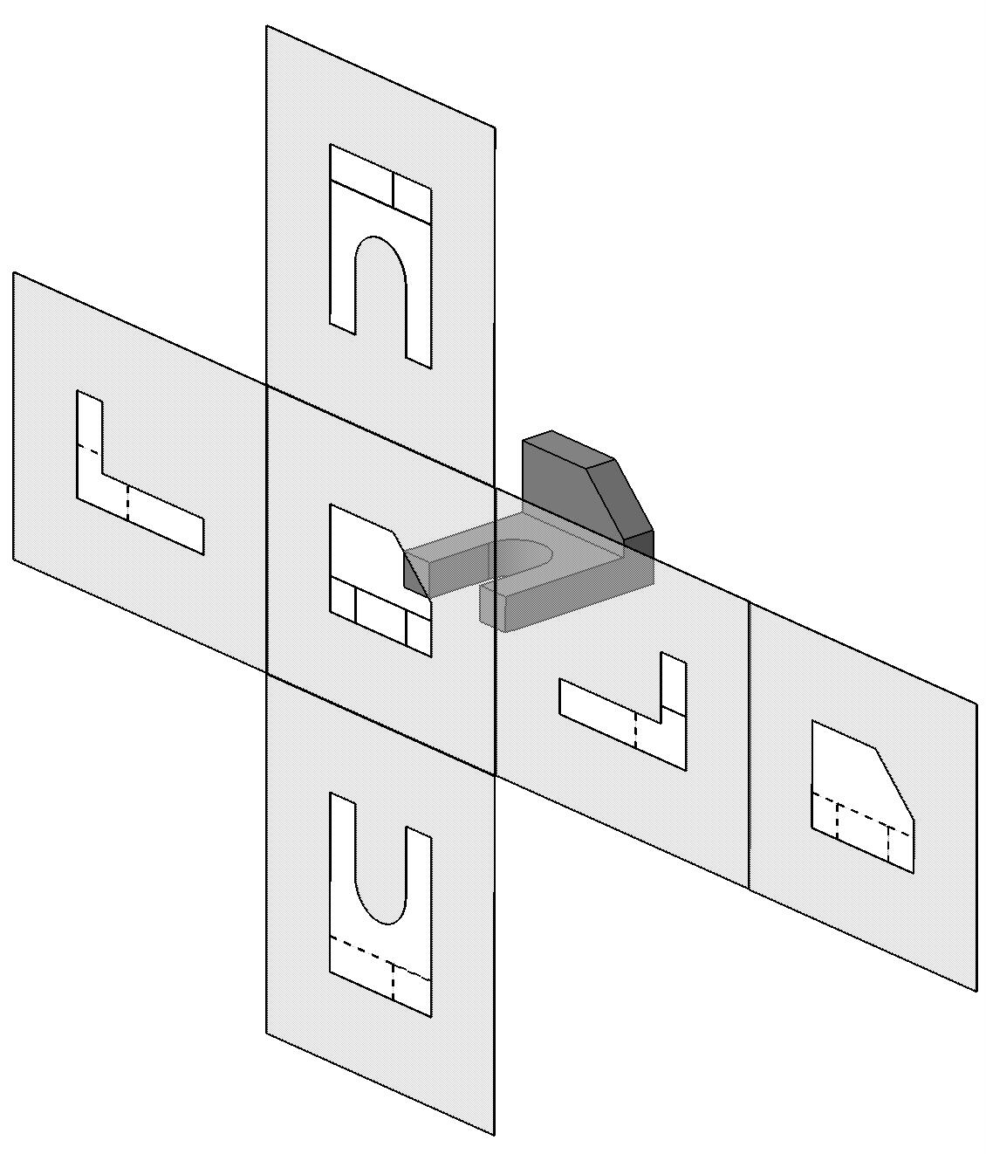
Glass Box Method
The box is unfolded creating the 6 principal views.

Slide 21
Exercise 1-1
Principal Views

Slide 22
Exercise 1-1
Label the 5 remaining principal views with the appropriate view name.

Slide 23
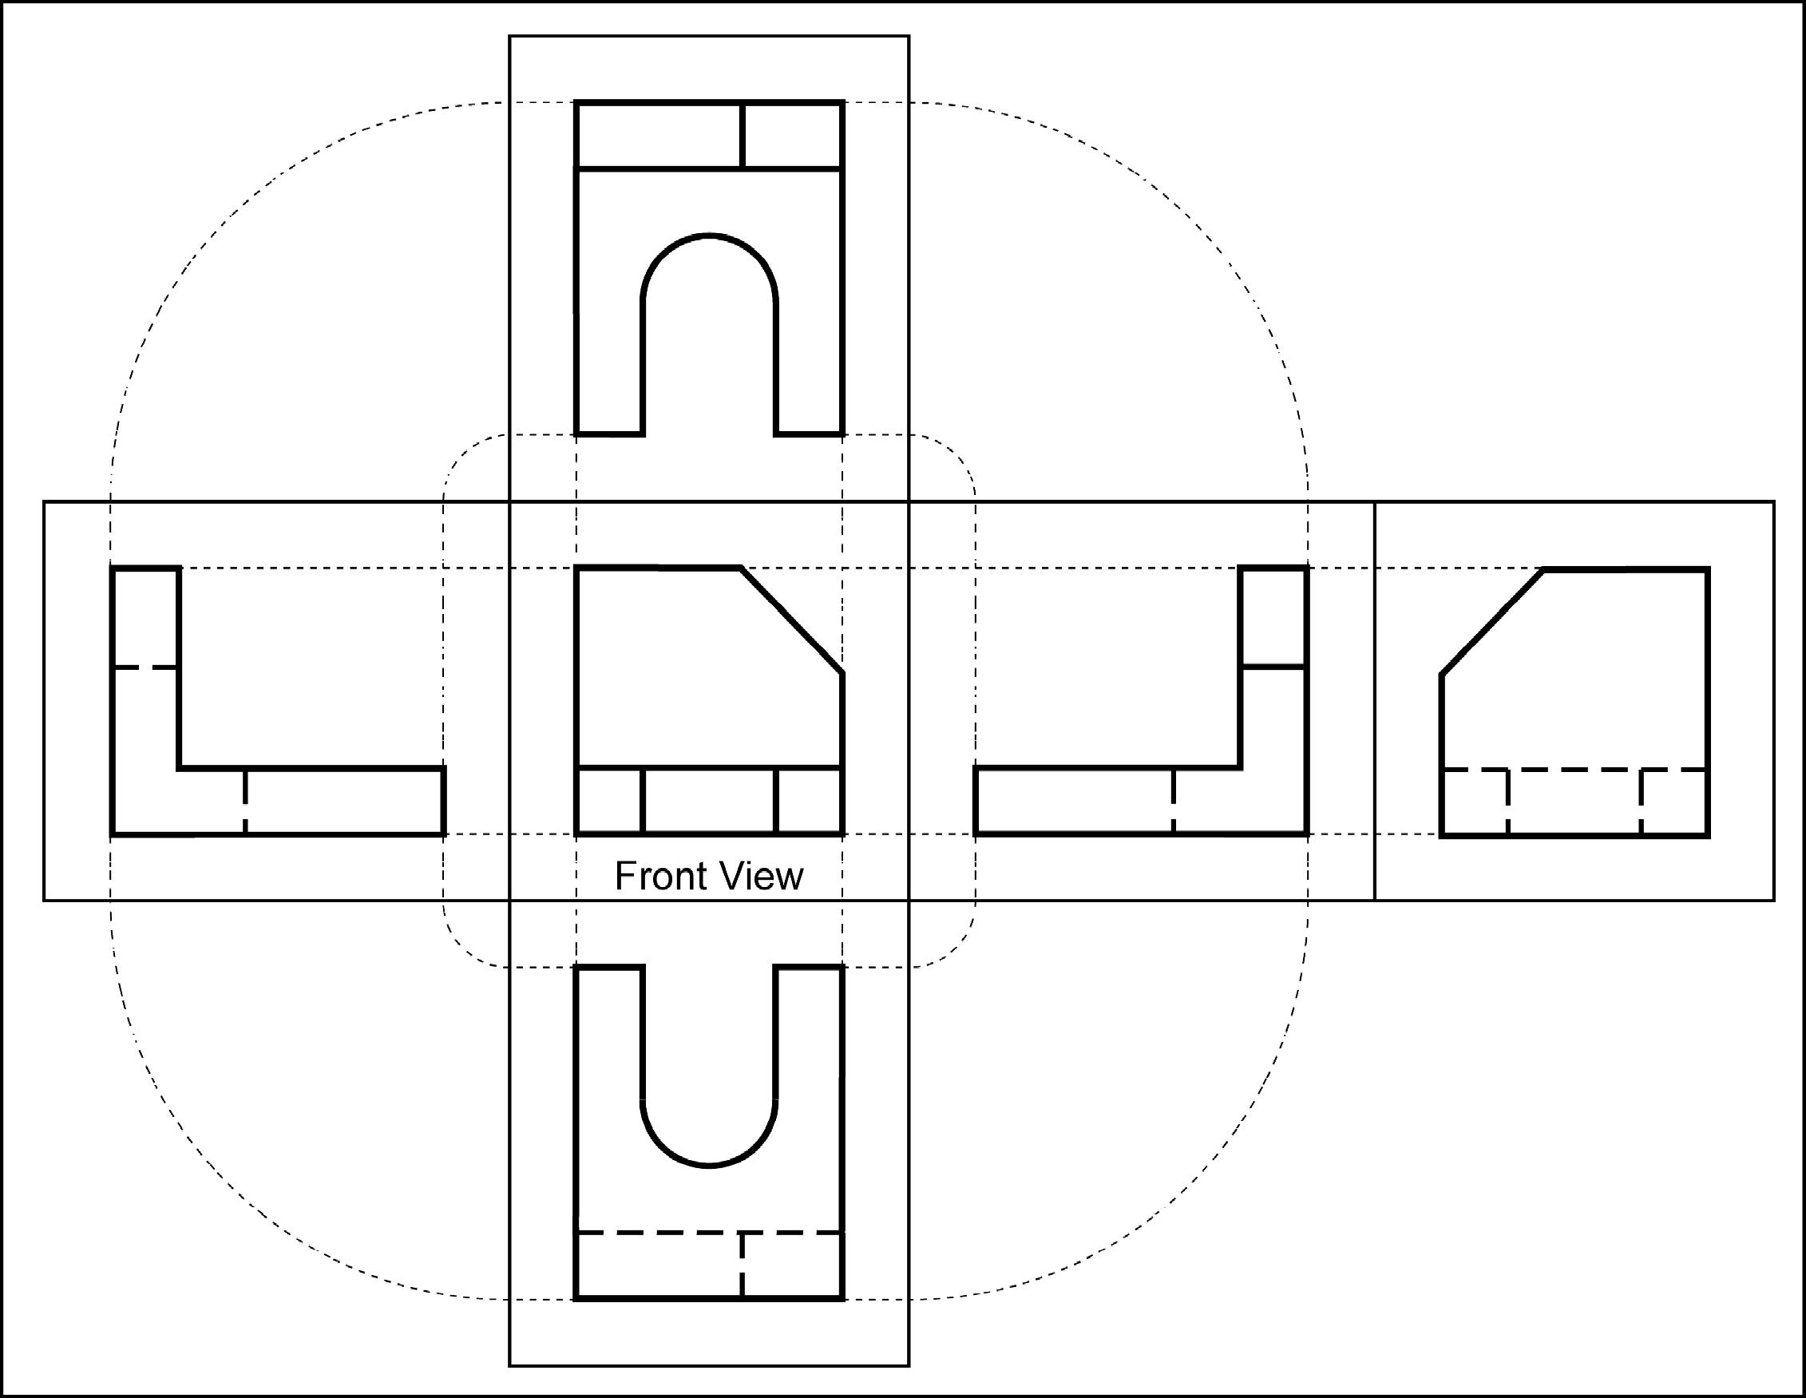
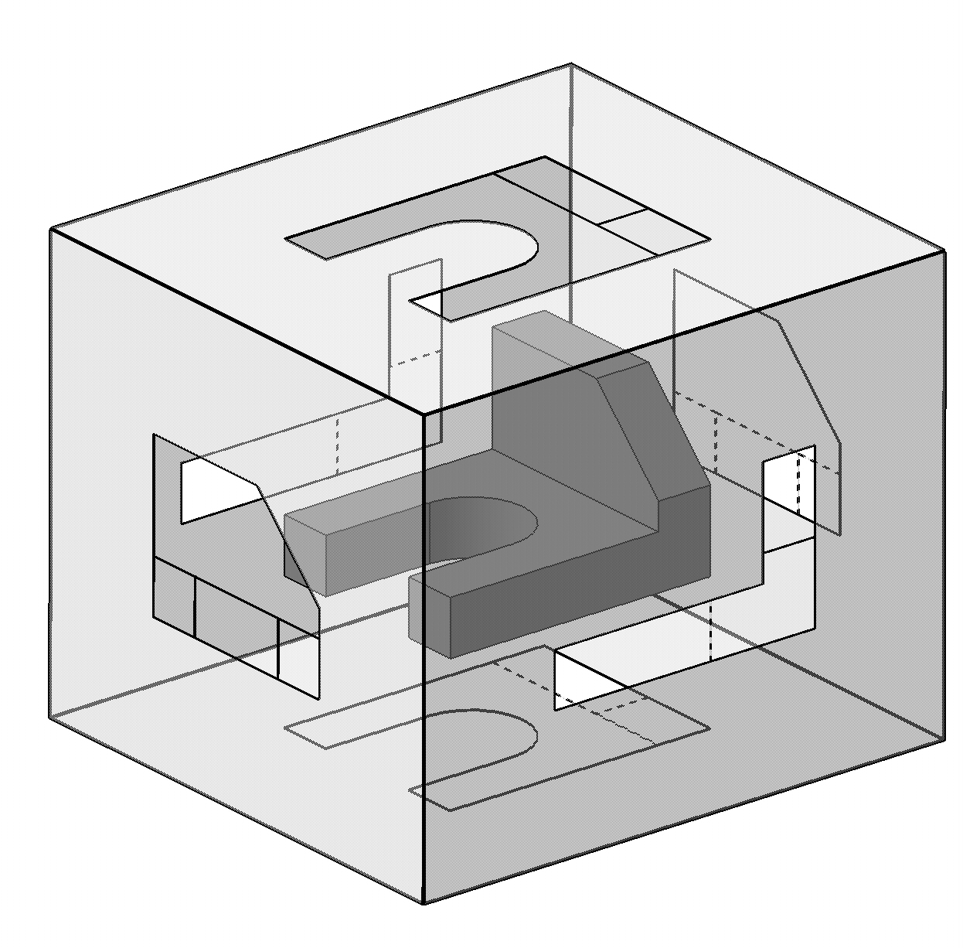
Name each view.
Top

Slide 24
Name each view.
Top
Right Side

Slide 25
Name each view.
Top
Right Side
Rear

Slide 26
Name each view.
Top
Left Side
Right Side
Rear

Slide 27
Name each view.
Top
Left Side
Right Side
Rear
Bottom

Slide 28
What are the differences between the Right Side and Left Side views?
Top
Left Side
Right Side
Rear
They are mirror images with one different line type.
Bottom

Slide 29
What are the differences between the Top and Bottom, and Front and Rear views?
Top
Left Side
Right Side
Rear
They are mirror images with different line types.
Bottom

Slide 30
Which view(s) have the least amount of hidden or dashed lines?
Top
Front and top views.
Left Side
Right Side
Rear
Bottom

Slide 31
Orthographic Projection
1.4) The Standard Views

Slide 32
Standard Views
When constructing an orthographic projection, we need to include enough views to completely describe the true shape of the part.
Complex part = more views
Simple part = less views

Slide 33
Standard Views
The standard views used in an orthographic projection are;
Front view
Top view
Right side view
The remaining 3 views usually don’t add any new information.

Slide 34
Standard Views
How many views do we need to completely describe a block?

Slide 35
Standard Views
How many views do we need to completely describe a block?
2 views.
The 3rd view duplicates information.

Slide 36
Standard Views
How many views do we need to completely describe a sphere?
1 view.
A sphere has only one dimension. Its diameter.

Slide 37
Front View
The front view shows the most features or characteristics of the object.
It usually contains the least amount of hidden lines.
The front view is chosen first and the other views are based on the orientation of the front view.

Slide 38
View Alignment
The top and front views are aligned vertically and share the same width dimension.
The front and right side views are aligned horizontally and share the same height dimension.

Slide 40
Orthographic Projection
1.5) Lines Types Used in an Orthographic Projection

Slide 41
Line Type and Weight
Line type and line weight provide valuable information to the print reader.
For example, line type and weight can answer the following questions.
Is the feature visible or hidden from view?
Is the line part of the object or part of a dimension?
Is the line indicating symmetry?

Slide 42
Line Type and Weight
There are four commonly used line types;
continuous
hidden
center
phantom

Slide 43
Line Type and Weight
Some lines are more important than others. Importance is indicated by line weight or thickness.
The thicker the line, the more important it is.

Slide 44
Line Types
Visible lines:
Visible lines represent visible edges and boundaries.
Continuous and thick (0.5 - 0.6 mm).
Hidden lines:
Hidden lines represent edges and boundaries that cannot be seen.
Dashed and medium thick (0.35 - 0.45 mm).

Slide 45
Line Types
Center lines:
Represent axes of symmetry.
Long dash – short dash and thin (0.3 mm).

Slide 46
Line Types
Phantom line:
Phantom lines are used to indicate imaginary features.
alternate positions of moving parts
adjacent positions of related parts
The line type is long dash – short dash – short dash and the line weight is usually thin (0.3 mm).

Slide 47
Line Types
Dimension and Extension lines:
Dimension and extension lines are used to show the size of an object.
In general, a dimension line is placed between two extension lines and is terminated by arrowheads, which indicates the direction and extent of the dimension.
The line type is continuous and the line weight is thin (0.3 mm).

Slide 48
Line Types
Cutting Plane line:
Cutting plane lines are used to show where an imaginary cut has been made through the object in order to view interior features.
The line type is phantom and the line weight is very thick (0.6 to 0.8 mm).
Arrows are placed at both ends of the cutting plane line to indicate the direction of sight.

Slide 49
Line Types
Section line:
Section lines are used to show areas that have been cut by the cutting plane.
Section lines are grouped in parallel line patterns and usually drawn at a 45° angle.
The line type is usually continuous and the line weight is thin (0.3 mm).

Slide 50
Line Types
Break line:
Break lines are used to show imaginary breaks in objects.
A break line is usually made up of a series of connecting arcs.
The line type is continuous and the line weight is usually thick (0.5 – 0.6 mm).

Slide 51
Exercise 1-2
Line types

Slide 52
Example 1-2
Which of the following line types is a VISIBLE line?

Slide 53
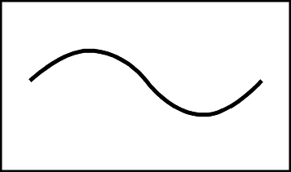
Example 1-2
Which of the following line types is a HIDDEN line?

Slide 54
Example 1-2
Which of the following line types is a CENTER line?

Slide 55
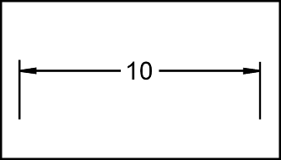
Example 1-2
Which of the following line types is a PHANTOM line?

Slide 56
Example 1-2
Which of the following line types is a DIMENSION & EXTENSION lines?

Slide 57
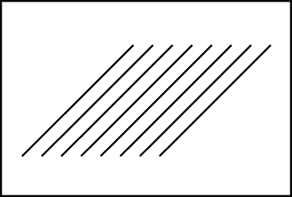
Example 1-2
Which of the following line types is a CUTTING PLANE line?

Slide 58
Example 1-2
Which of the following line types is a SECTION line?

Slide 59
Example 1-2
Which of the following line types is a BREAK line?

Slide 60
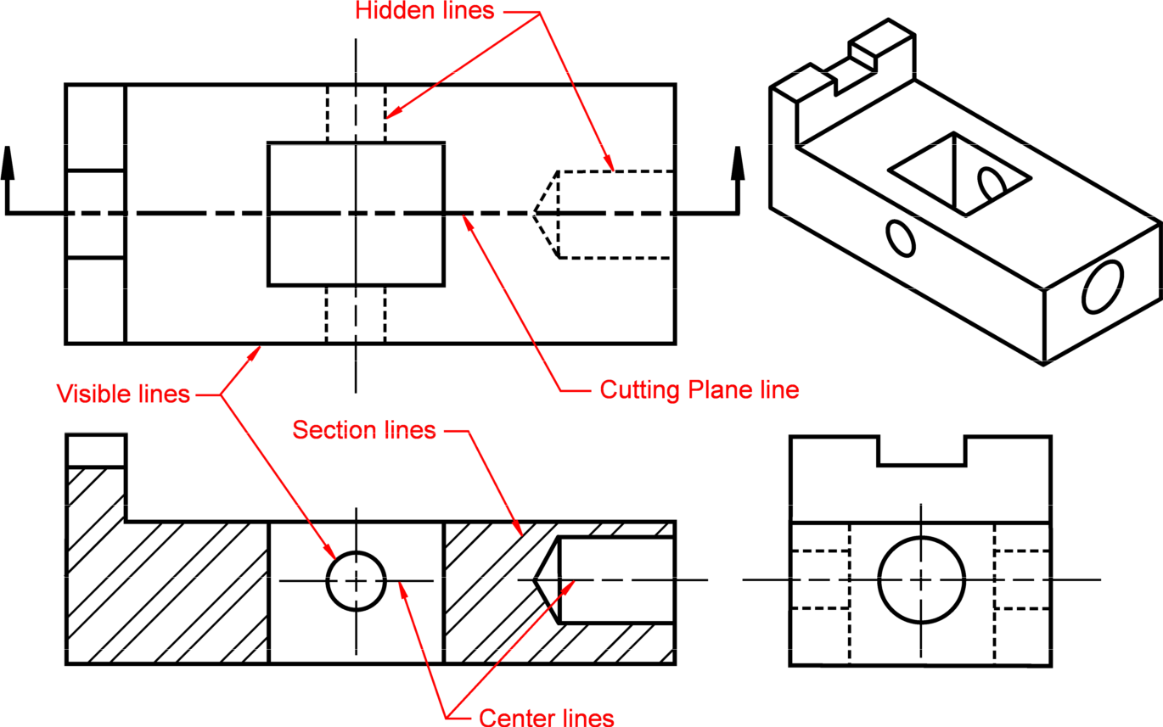
Example 1-2
Notice how different line types are used.

Slide 61
Exercise 1-3
Line use in an orthographic projection

Slide 62
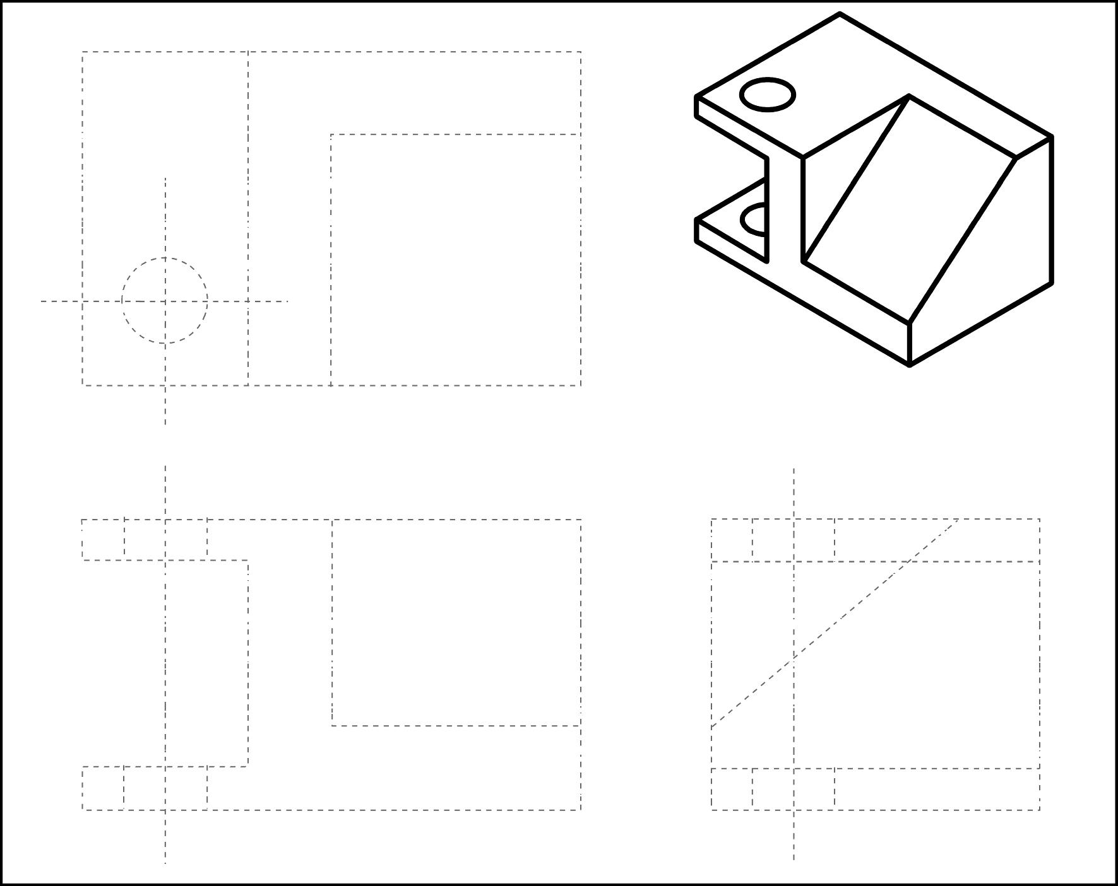
Exercise 1-3
Fill the following dotted orthographic projection with the appropriate line types.

Slide 63
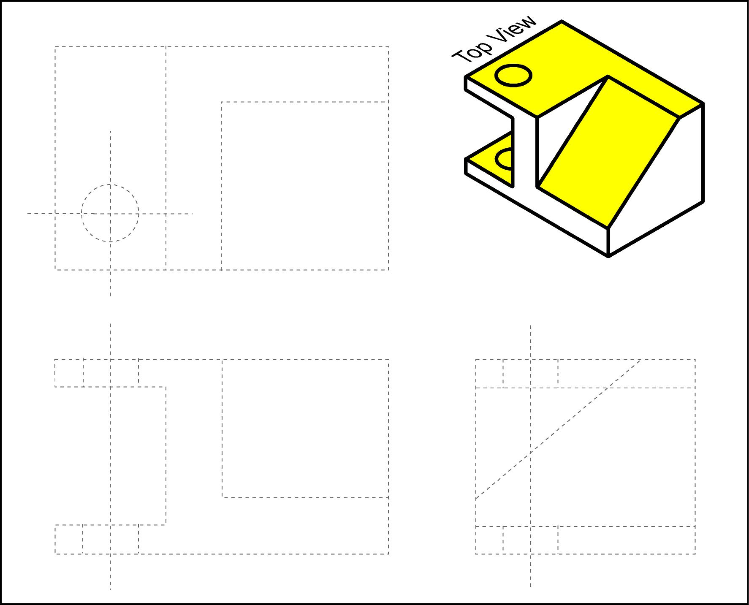
Fill in the visible lines in to top view.

Slide 64
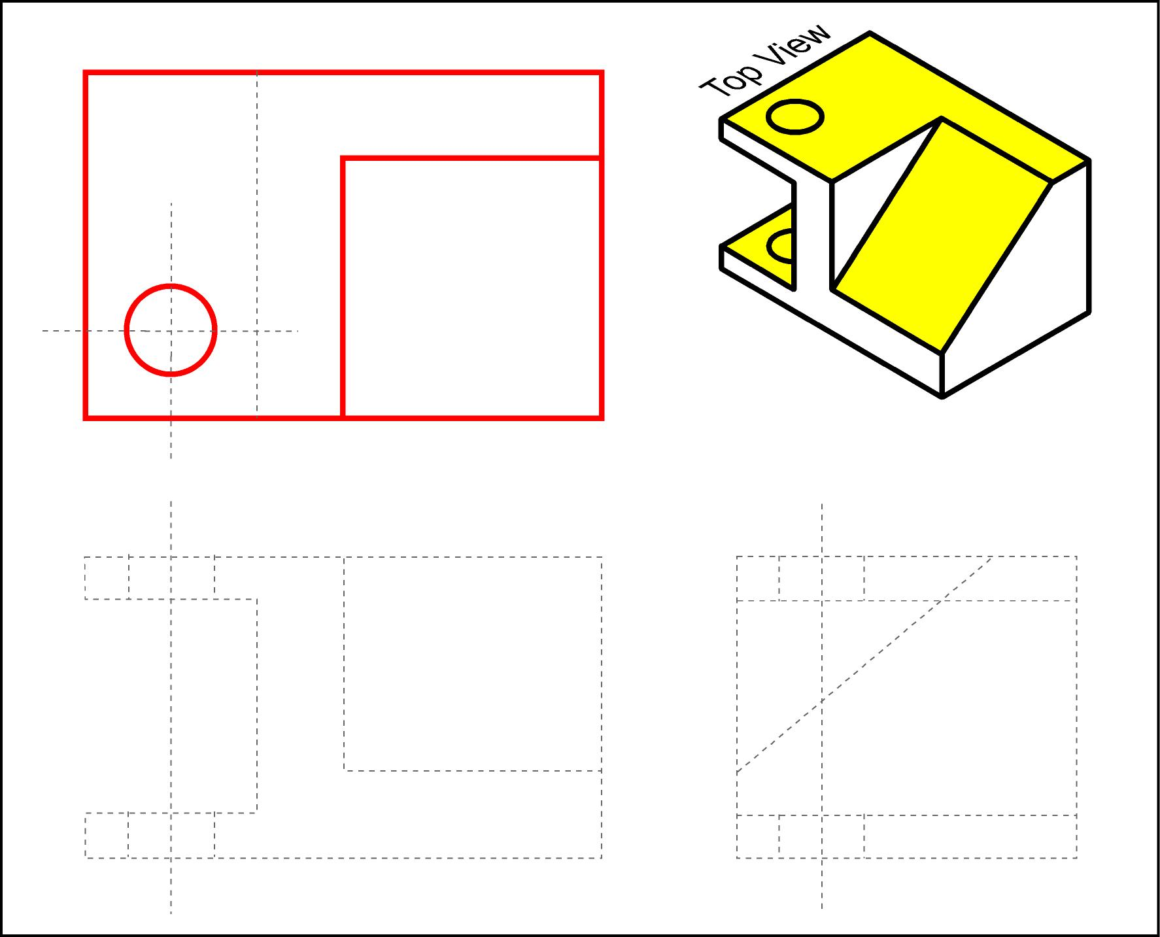

Slide 65
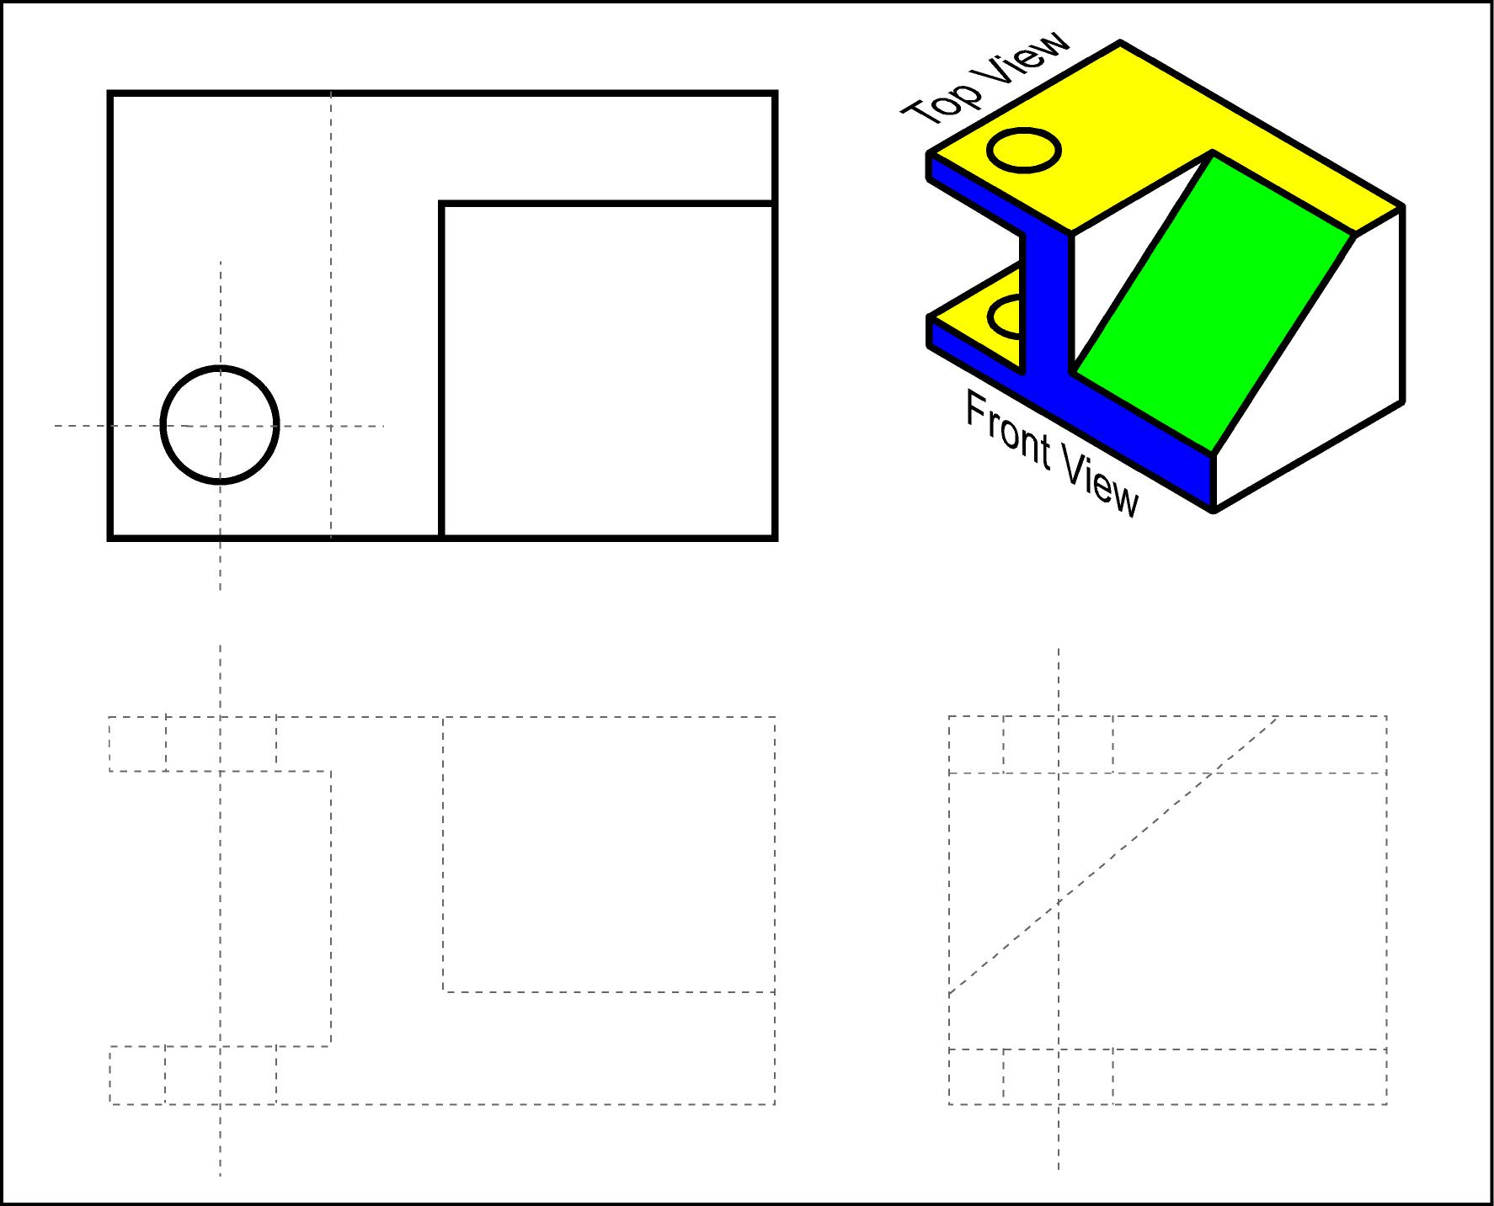
Fill in the visible lines in to front view.

Slide 66
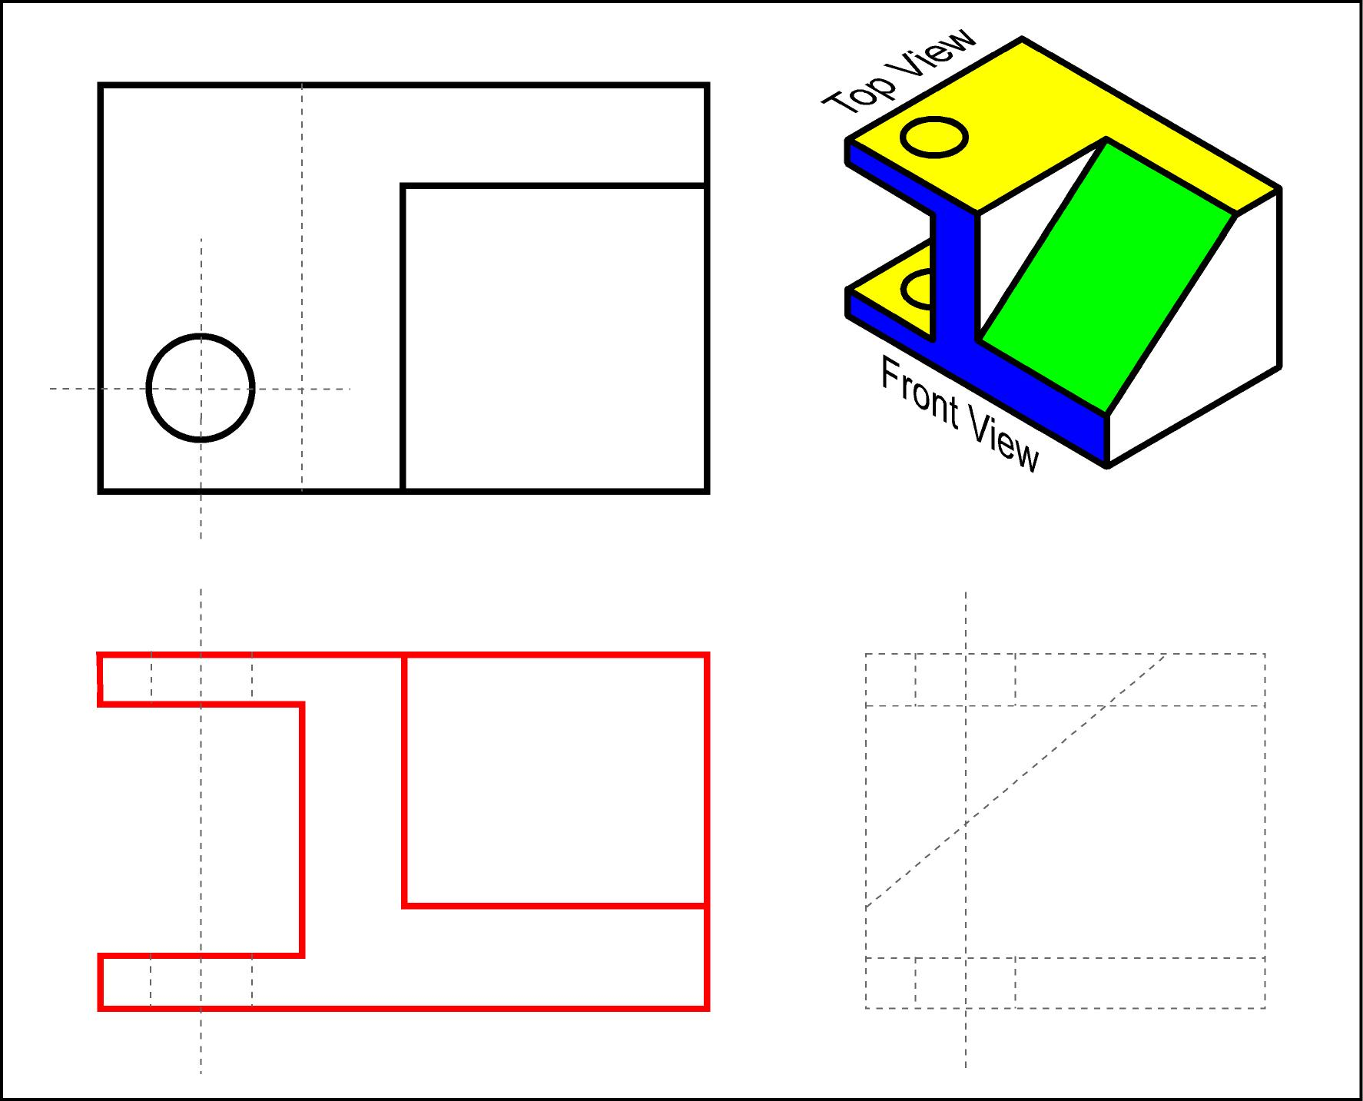

Slide 67
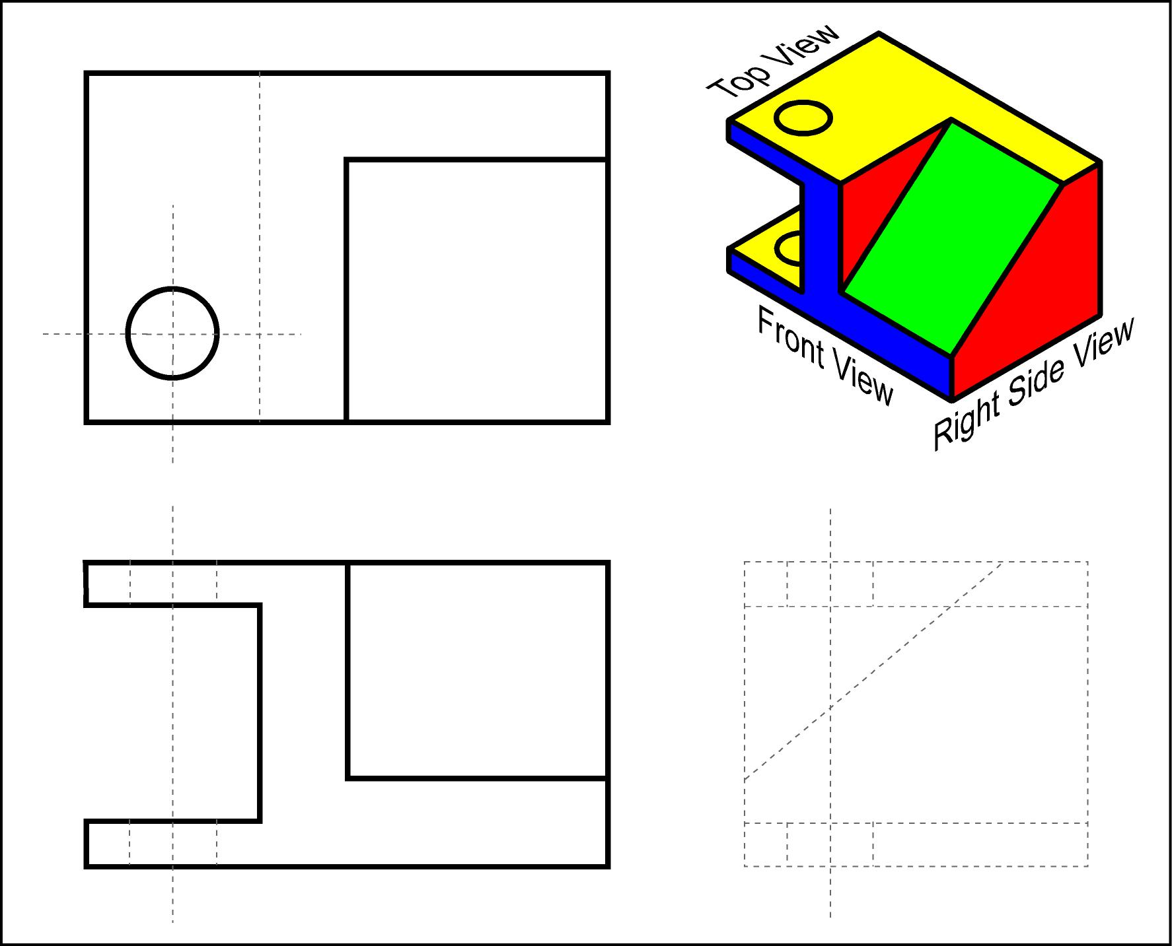
Fill in the visible lines in to right side view.

Slide 68
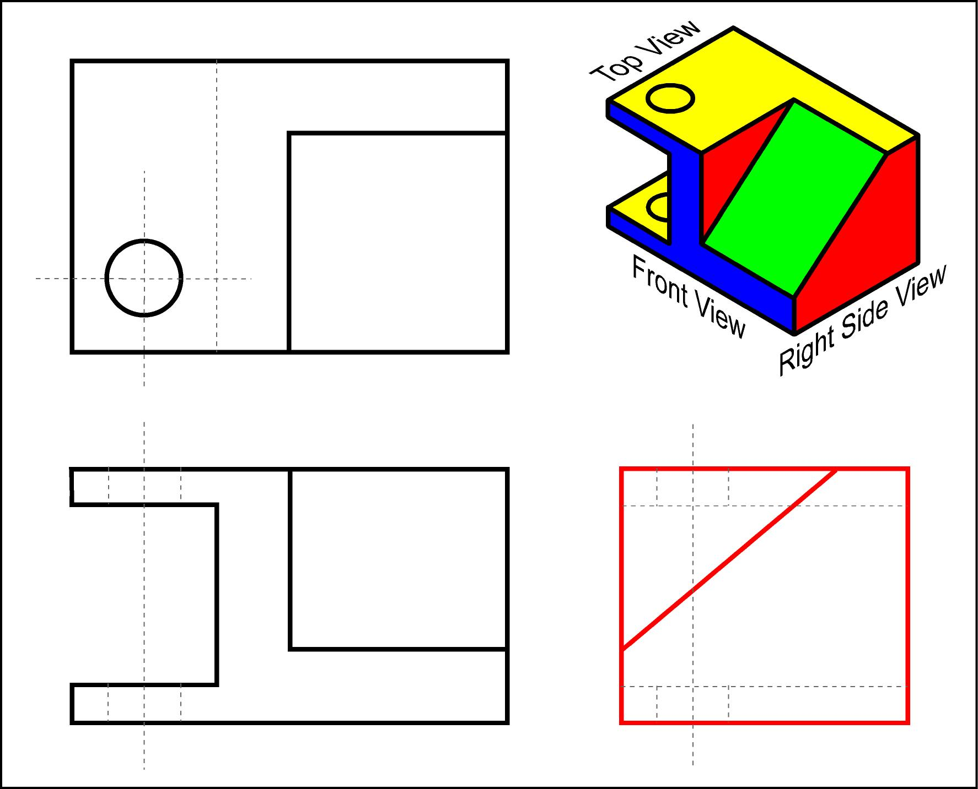

Slide 69
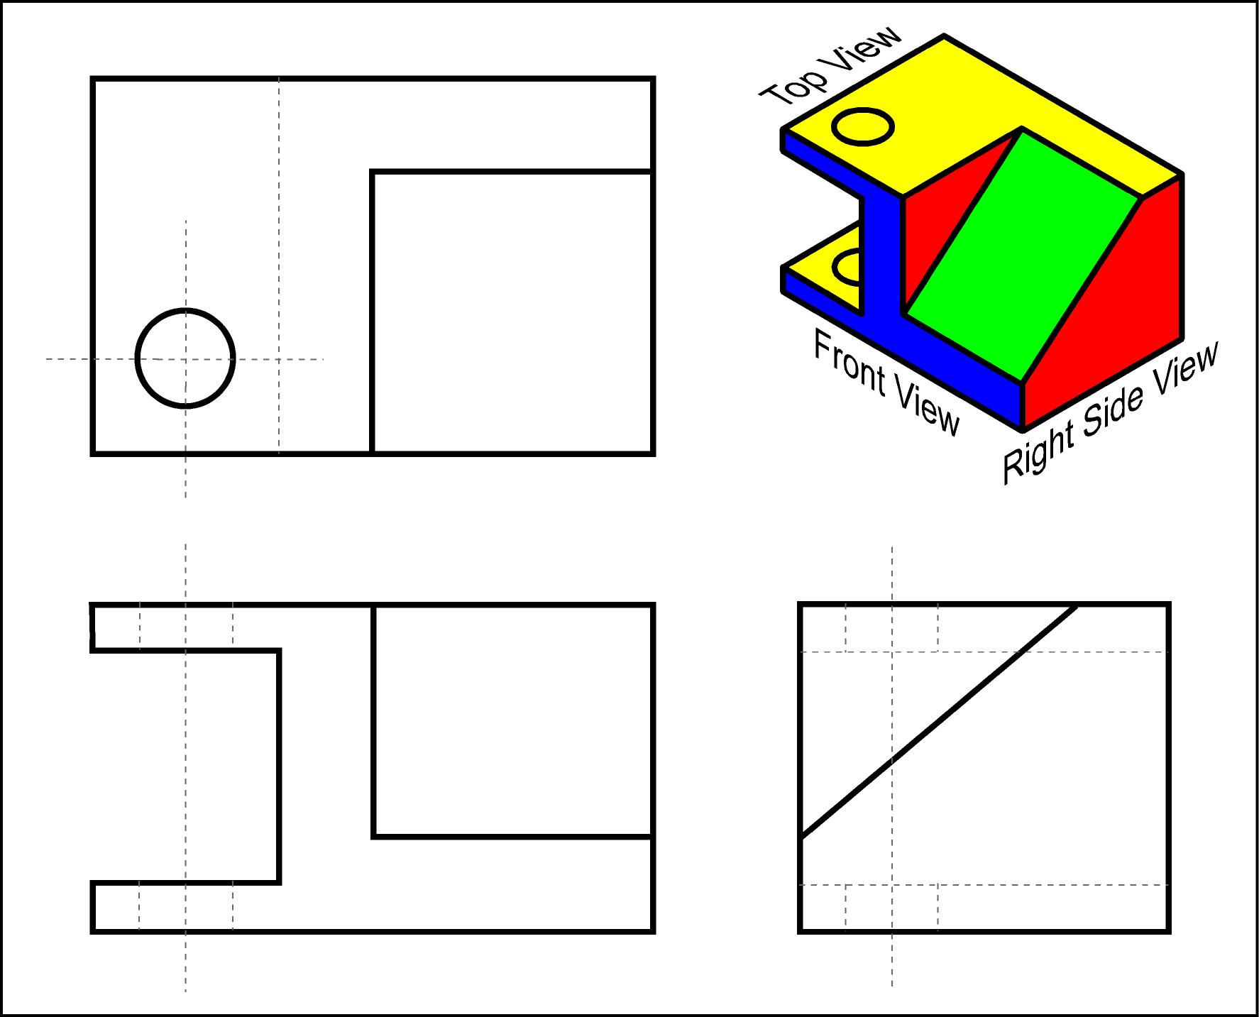
Fill in the hidden lines in to front, top and right side views.

Slide 70
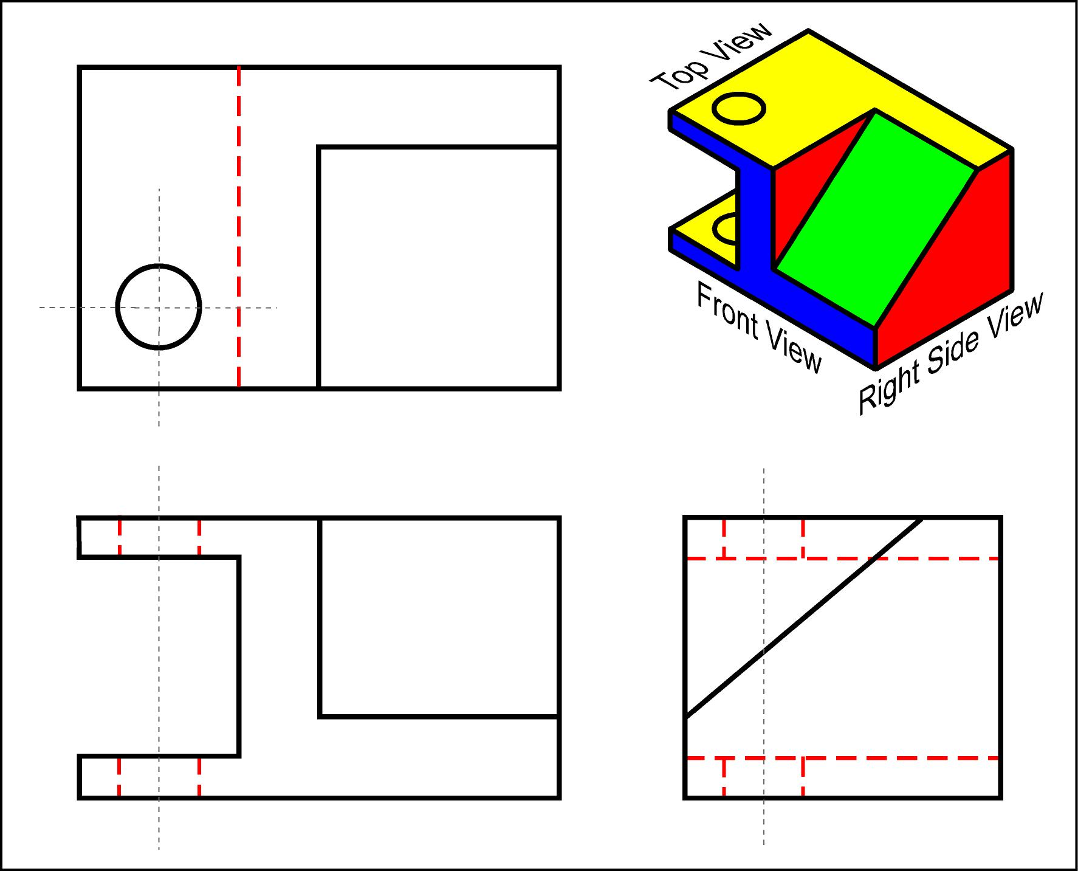

Slide 71
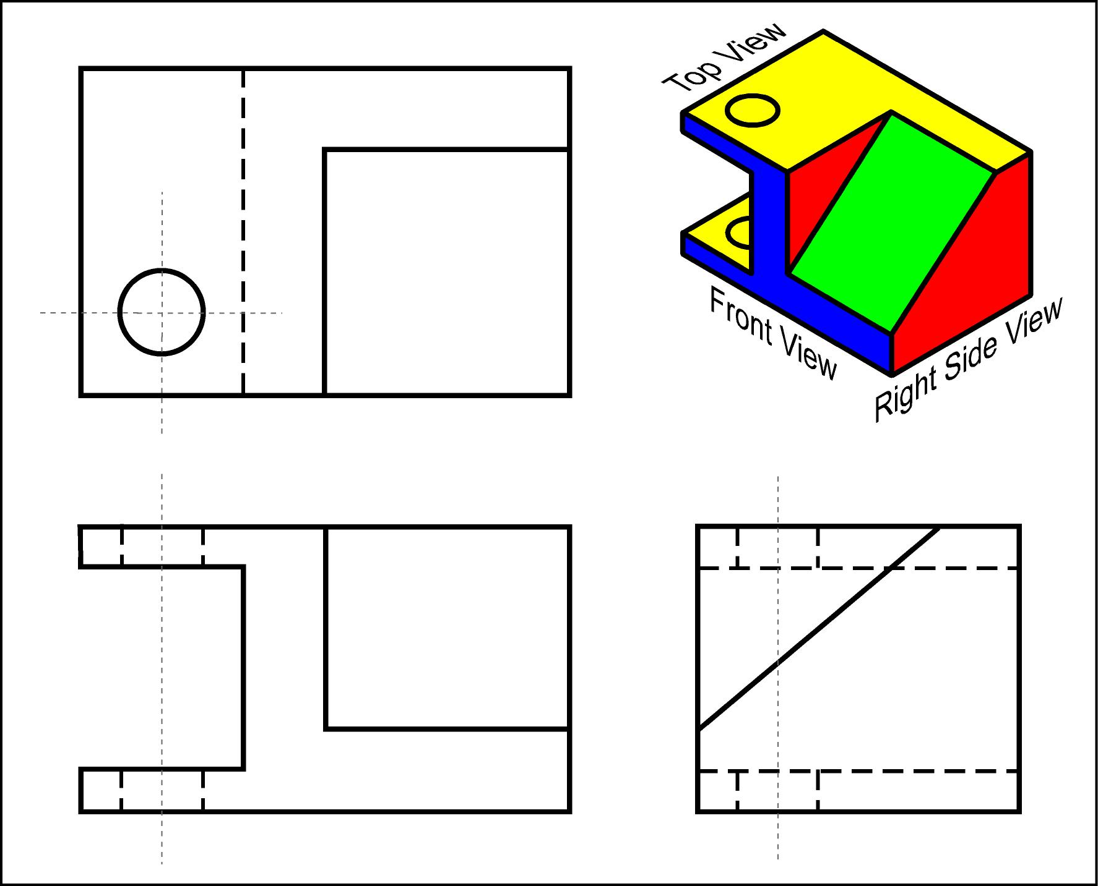
Draw the center lines in all the views.

Slide 72
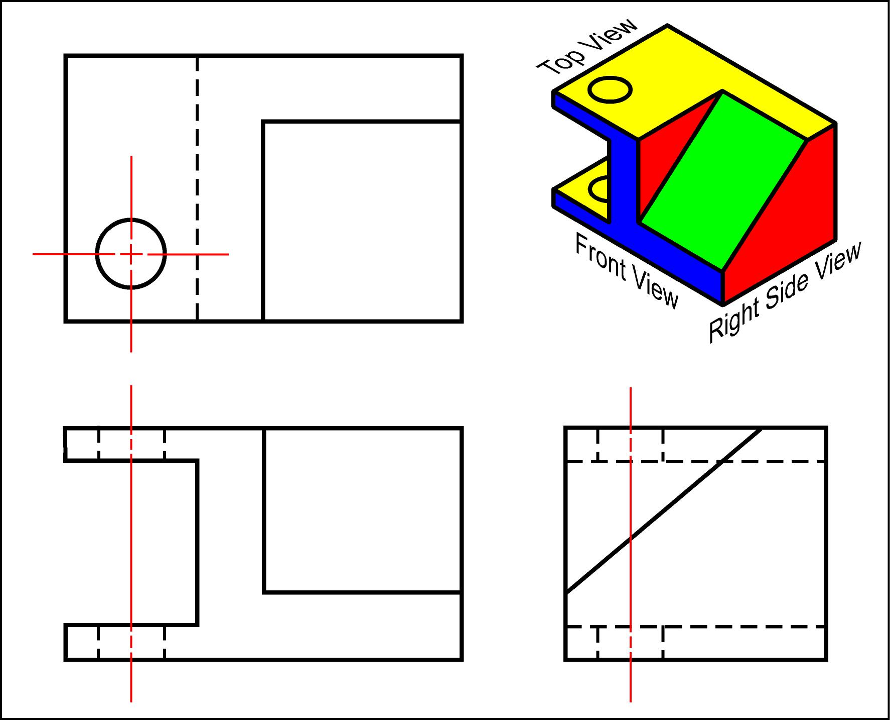
NOTICE!
The small dashes cross in the middle.
NOTICE!
The center line connects between features in the same view.

Slide 73
Orthographic Projection
1.6) Rules for Line Creation and Use

Slide 74
Rules for Line Creation and Use
The following rules will help us create lines that communicate effectively.
CAUTION! Due to computer automation, some of the rules may be hard to follow.

Slide 75
Using Hidden Lines
Hidden lines represent edges and boundaries that cannot be seen.

Slide 76
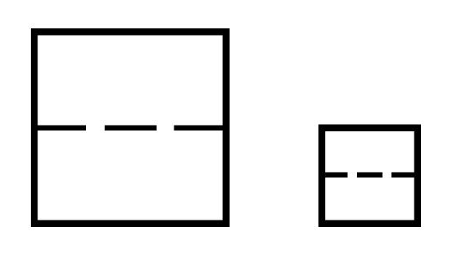
Creating Hidden Lines
Rule 1:
The length of the hidden line dashes may vary slightly as the size of the drawing changes.

Slide 77
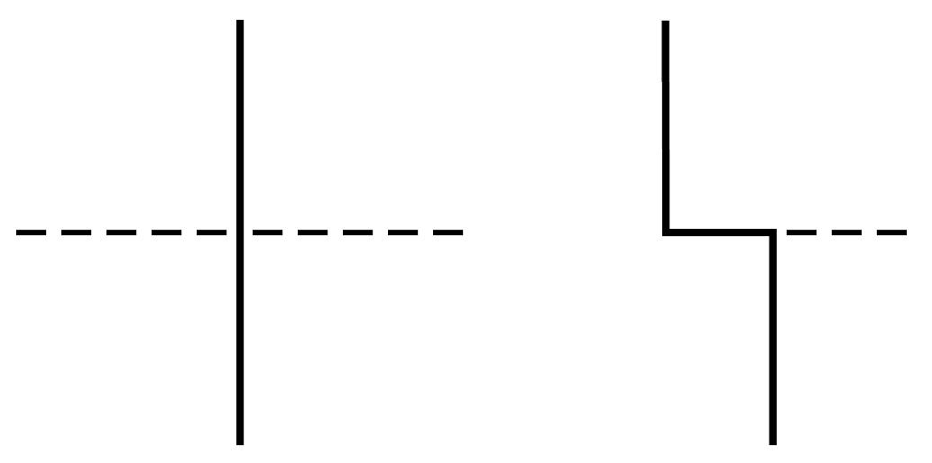
Creating Hidden Lines
Rule 2:
Hidden lines should always begin and end with a dash,
Exception: When the hidden line begins or ends at a parallel visible or hidden line.

Slide 78
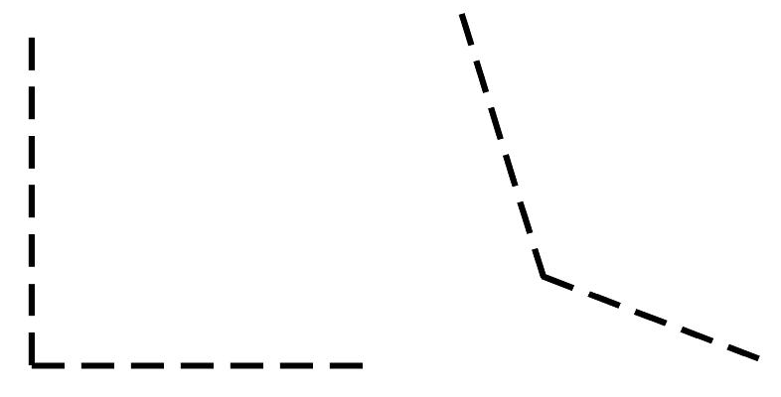
Creating Hidden Lines
Rule 3:
Dashes should join at corners.

Slide 79
Using Center Lines
Center lines represent axes of symmetry.
They are important for interpreting cylindrical shapes.

Slide 80
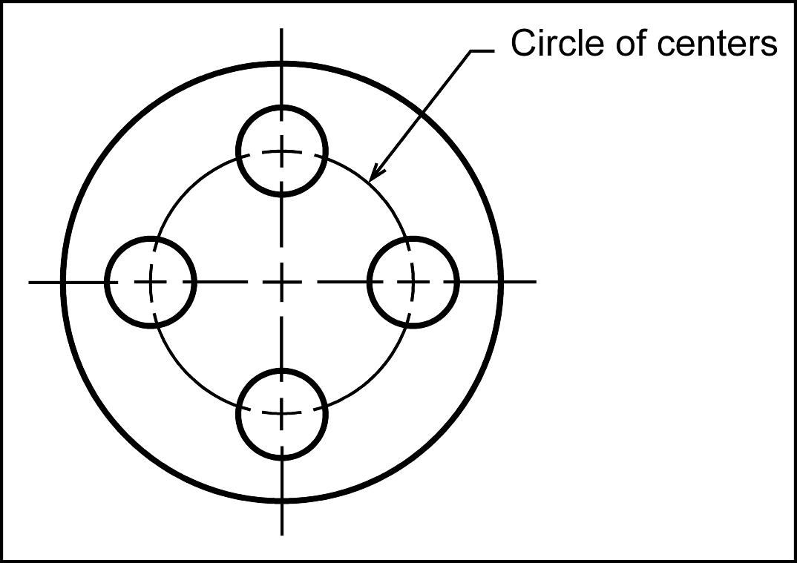
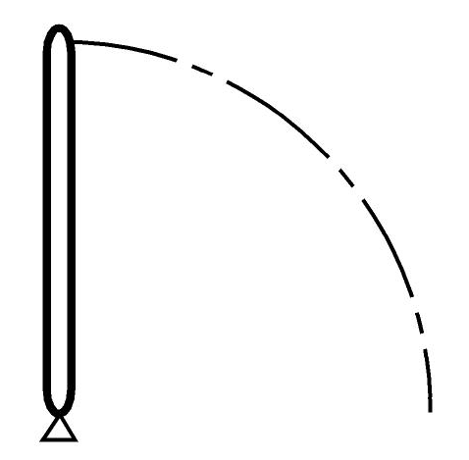
Using Center Lines
They are also used to indicate circle of centers, and paths of motion.

Slide 81
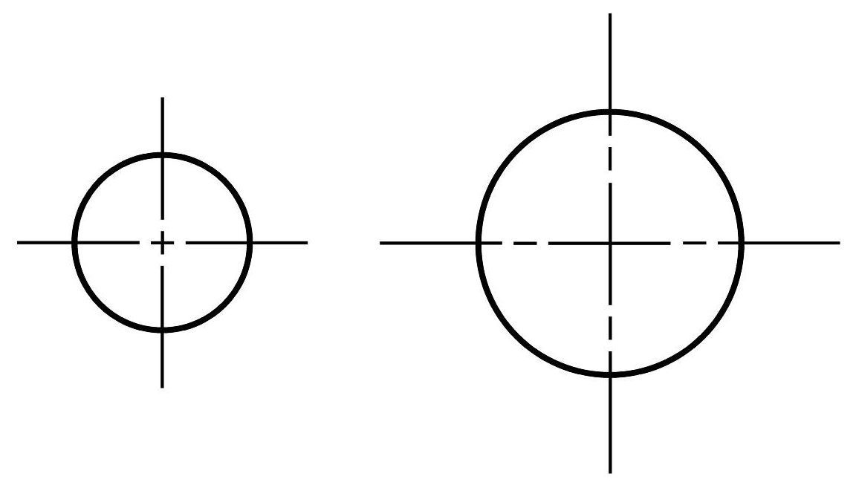
Creating Center Lines
Rule 1:
Center lines should start and end with long dashes.

Slide 82
Creating Center Lines
Rule 2:
Center lines should intersect by crossing either the long dashes or the short dashes.

Slide 83
Creating Center Lines
Rule 3:
Center lines should extend a short distance beyond the object or feature.

Slide 84
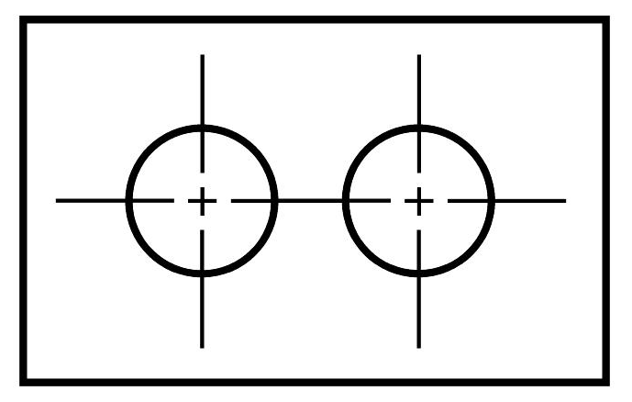
Creating Center Lines
Rule 4:
Center lines may be connected within a single view to show that two or more features lie in the same plane.
CAUTION! Center lines should not extend through the space between views .

Slide 85
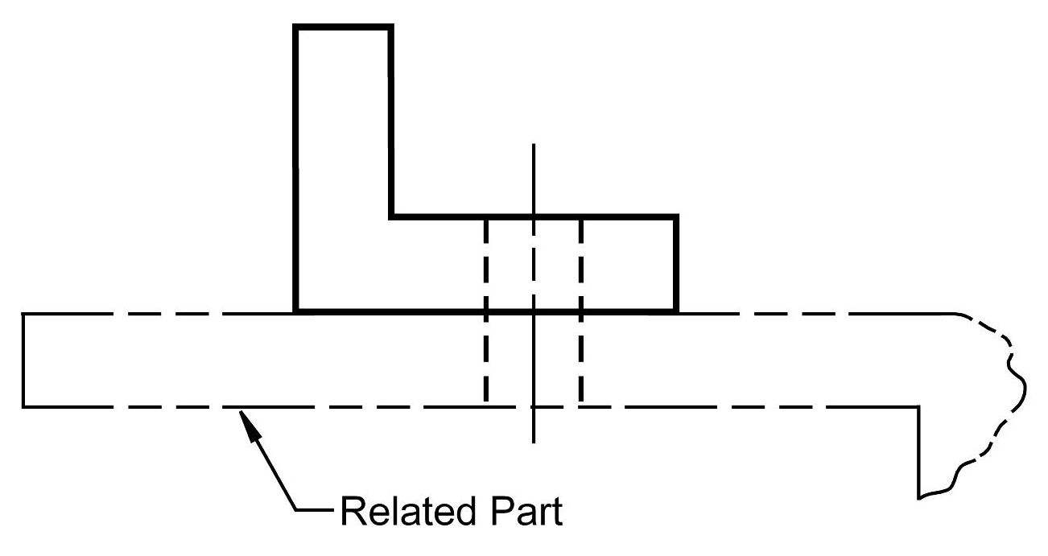
Using Phantom Lines
Phantom lines uses:
They may also be used to indicate adjacent positions of related parts.

Slide 86
Using Phantom Lines
Phantom lines uses:
Used to indicate repeated detail.

Slide 87
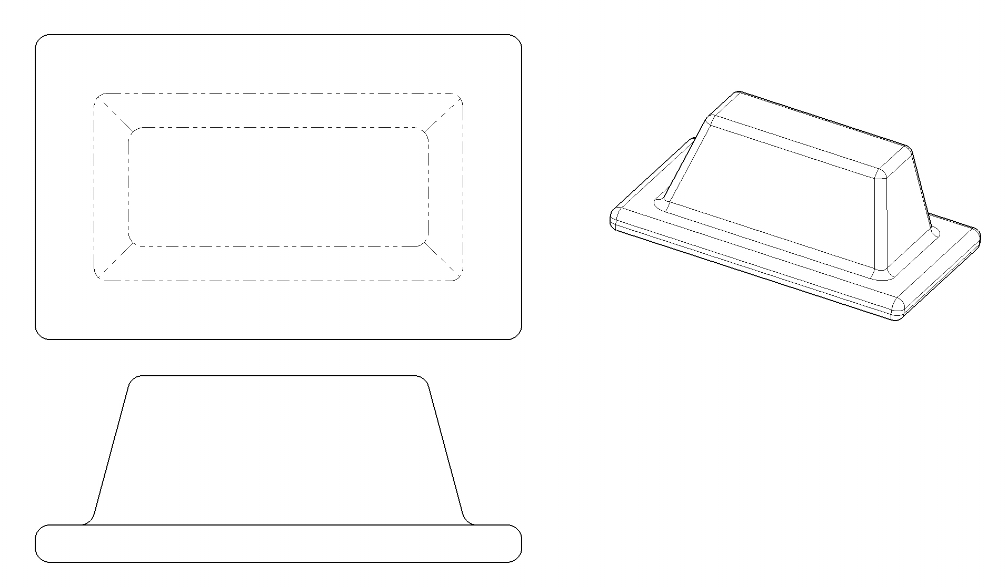
Using Phantom Lines
Phantom lines uses:
They are also used to show a change in surface direction produced by fillets and rounds.

Slide 88
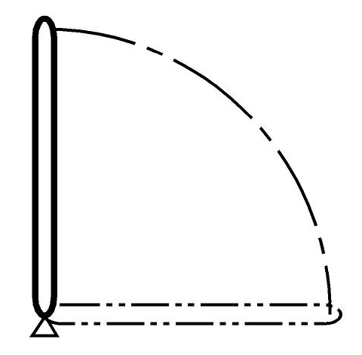
Using Phantom Lines
Phantom lines uses:
Used to indicate alternate positions of moving parts.

Slide 89
Creating Phantom Lines
Rule 1:
Phantom lines should start and end with a long dash.

Slide 90
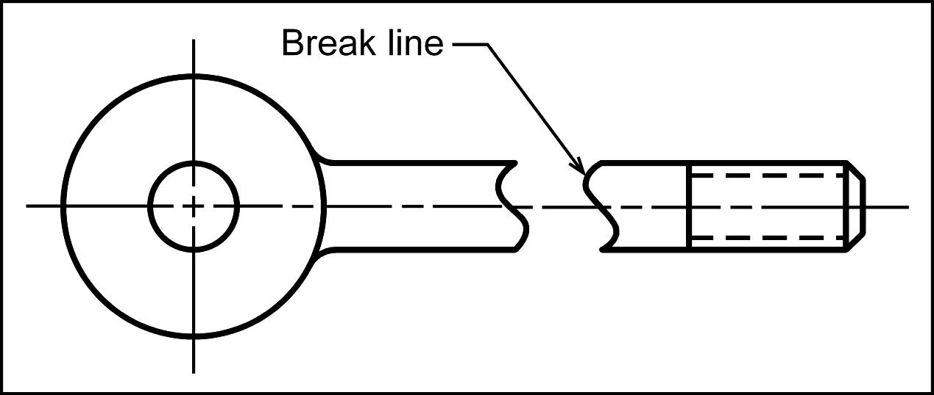
Using Break Lines
Break lines are used to show imaginary breaks in an object.

Slide 91
Creating Break Lines
There are two types of break lines.
If the distance to traverse is short the series of connecting arcs is used.

Slide 92
Creating Break Lines
There are two types of break lines.
If the distance is long the thin straight line with a jog is used.

Slide 93
Line Precedence
If two lines occur in the same place, the line that is considered to be the least important is omitted.
Lines in order of precedence/importance are as follows;
Cutting plane line
Visible line
Hidden line
Centerline

Slide 94
Orthographic Projection
1.7) Creating an Orthographic Projection

Slide 95
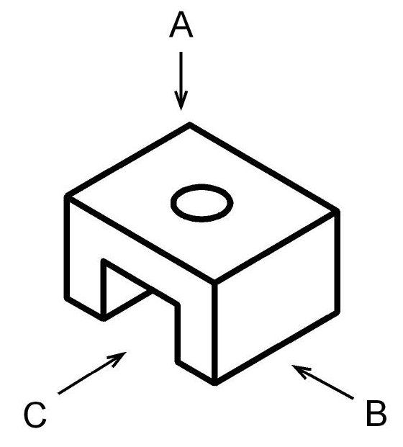
Creating an Orthographic Projection
Choose a front view.
Which view shows the most about the object?
C

Slide 96
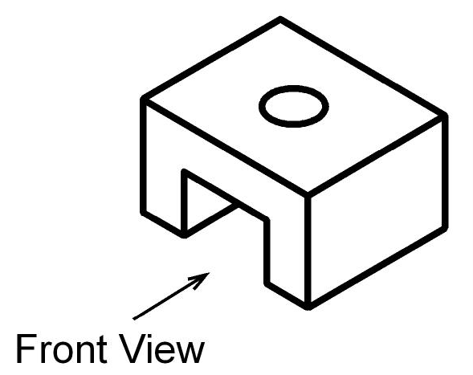
Creating an Orthographic Projection
Decide how many views are needed.
How many and which views?
2
Front
Top
For procedural reasons, we will continue this example by drawing all 3 standard views.

Slide 97
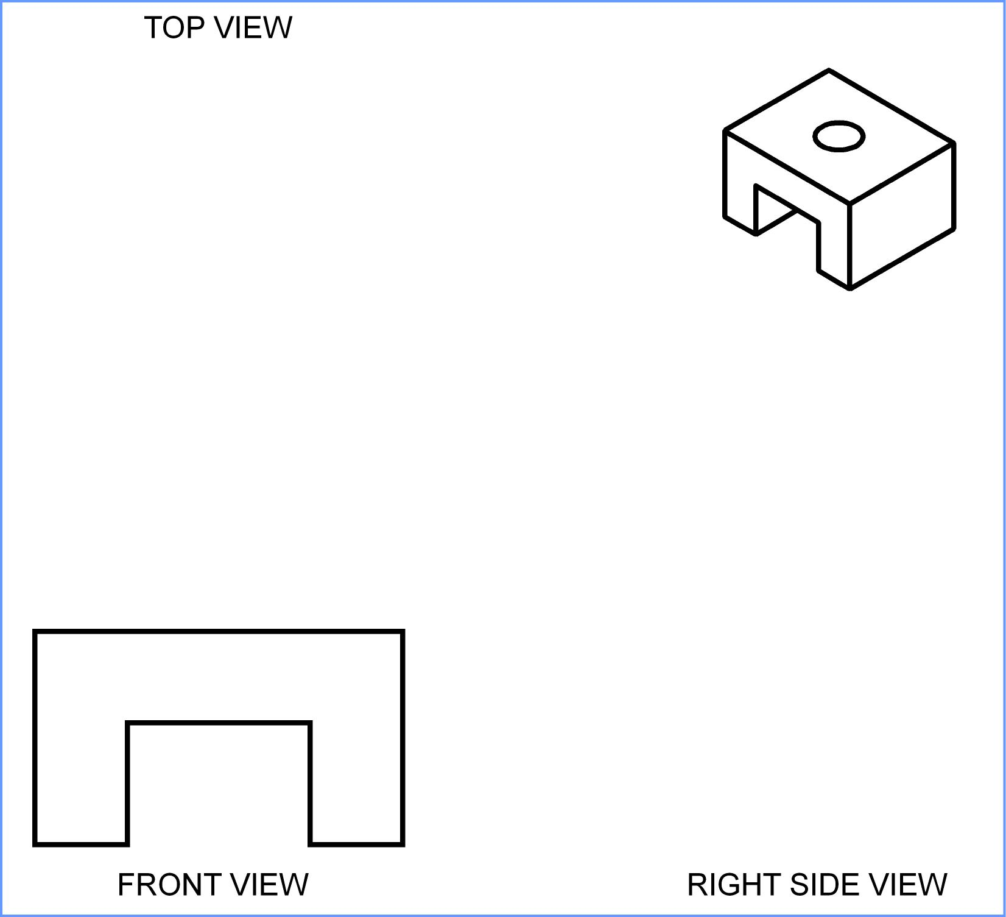
Creating an Orthographic Projection
Draw the visible features of the front view.

Slide 98
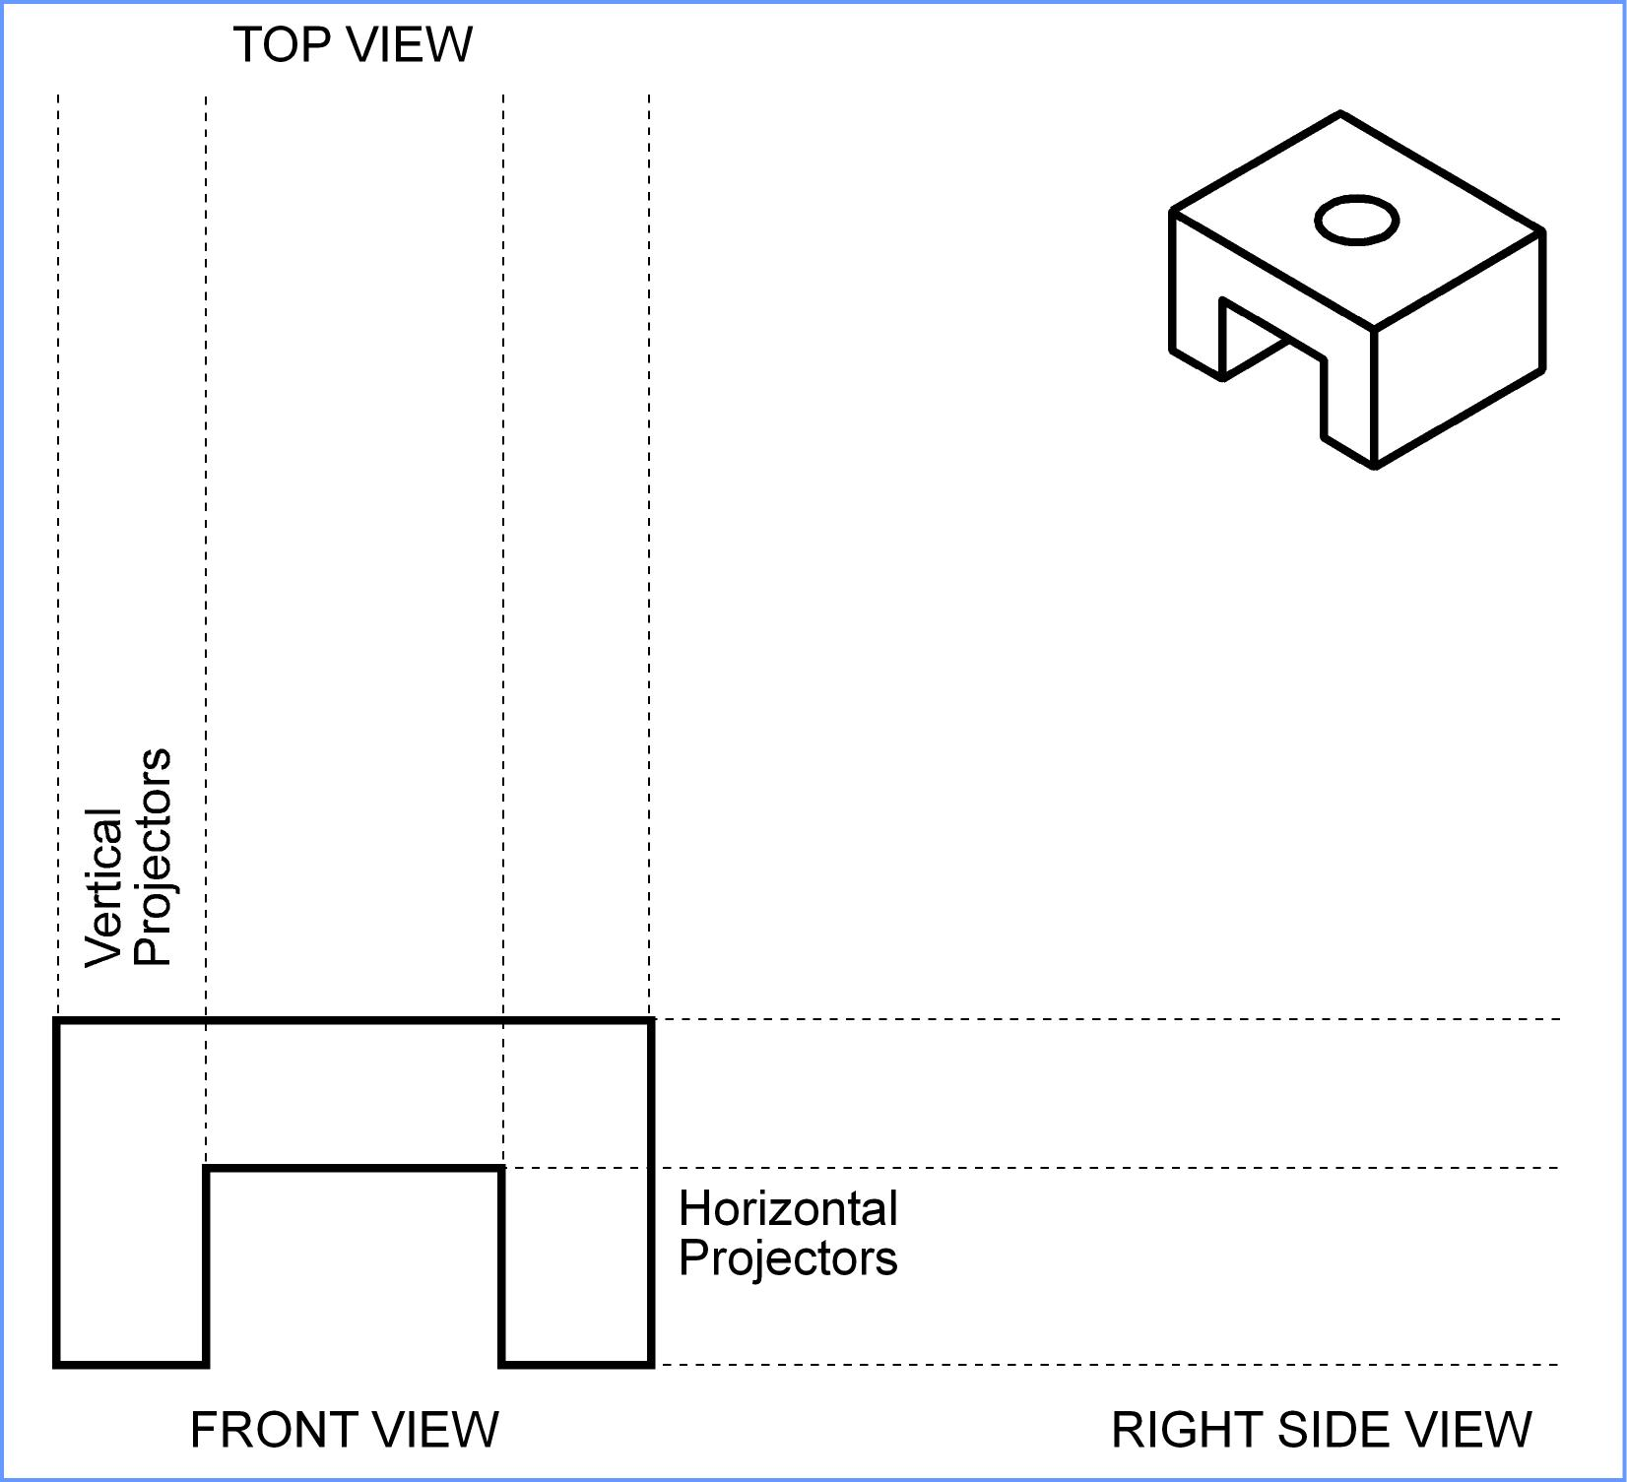
Creating an Orthographic Projection
Draw projectors off of the front view.

Slide 99
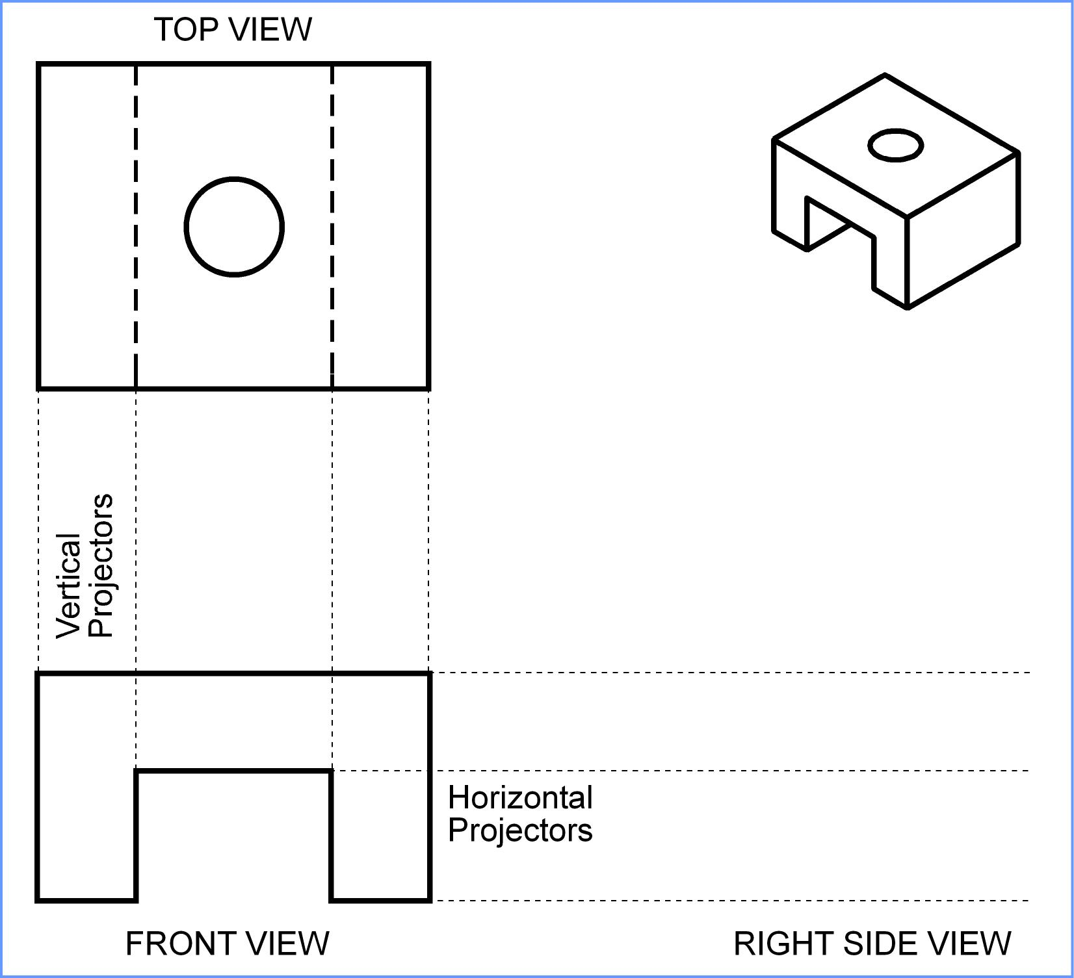
Creating an Orthographic Projection
Draw the top view.

Slide 100
Creating an Orthographic Projection
Project back to the front view.

Slide 101
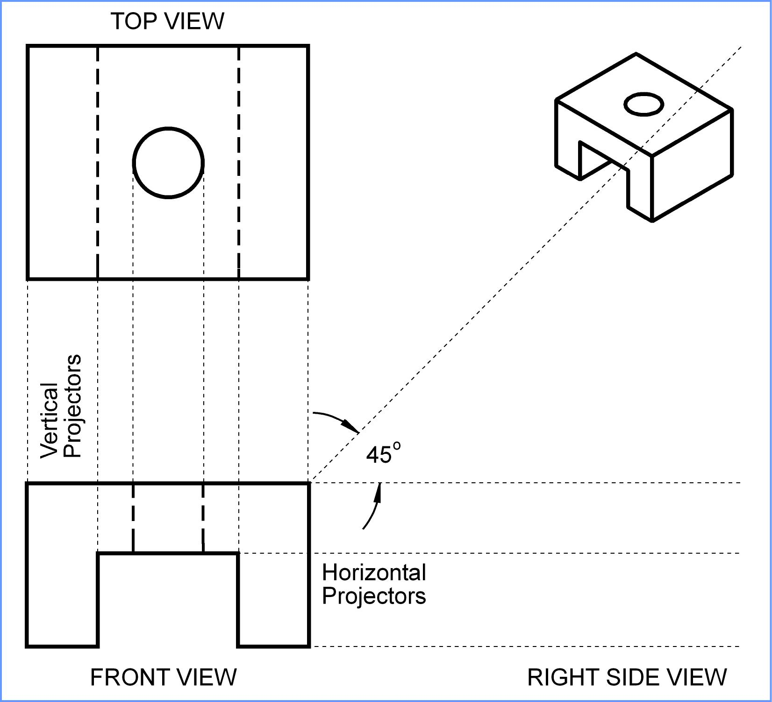
Creating an Orthographic Projection
Draw a 45° projector off the front view.

Slide 102
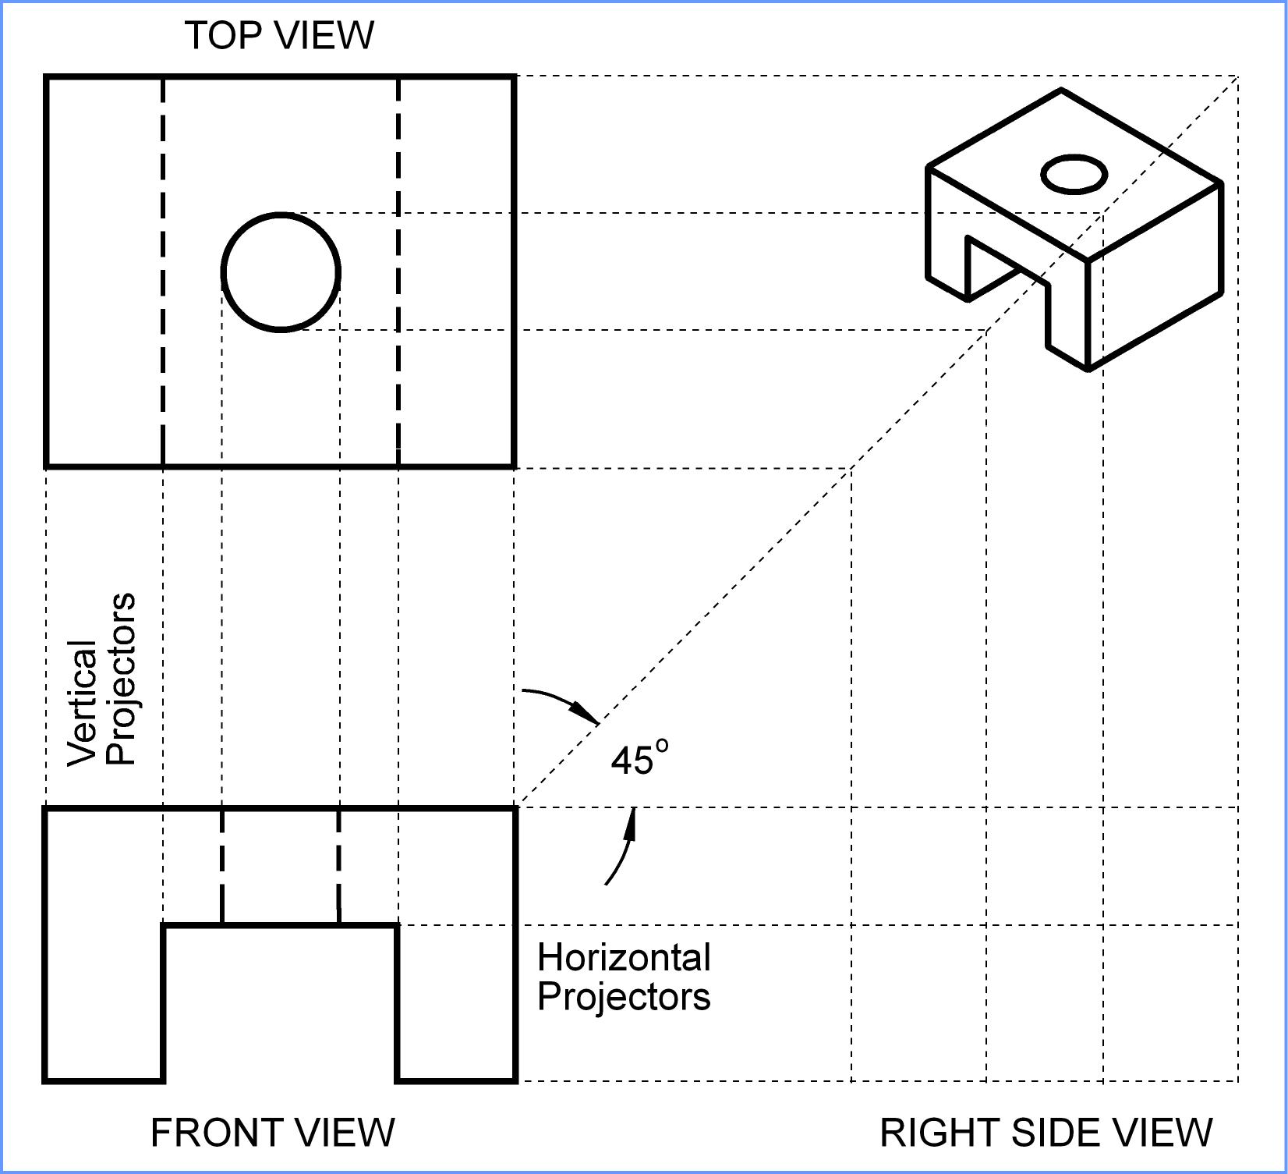
Creating an Orthographic Projection
Draw projectors over to the 45° line and down.

Slide 103
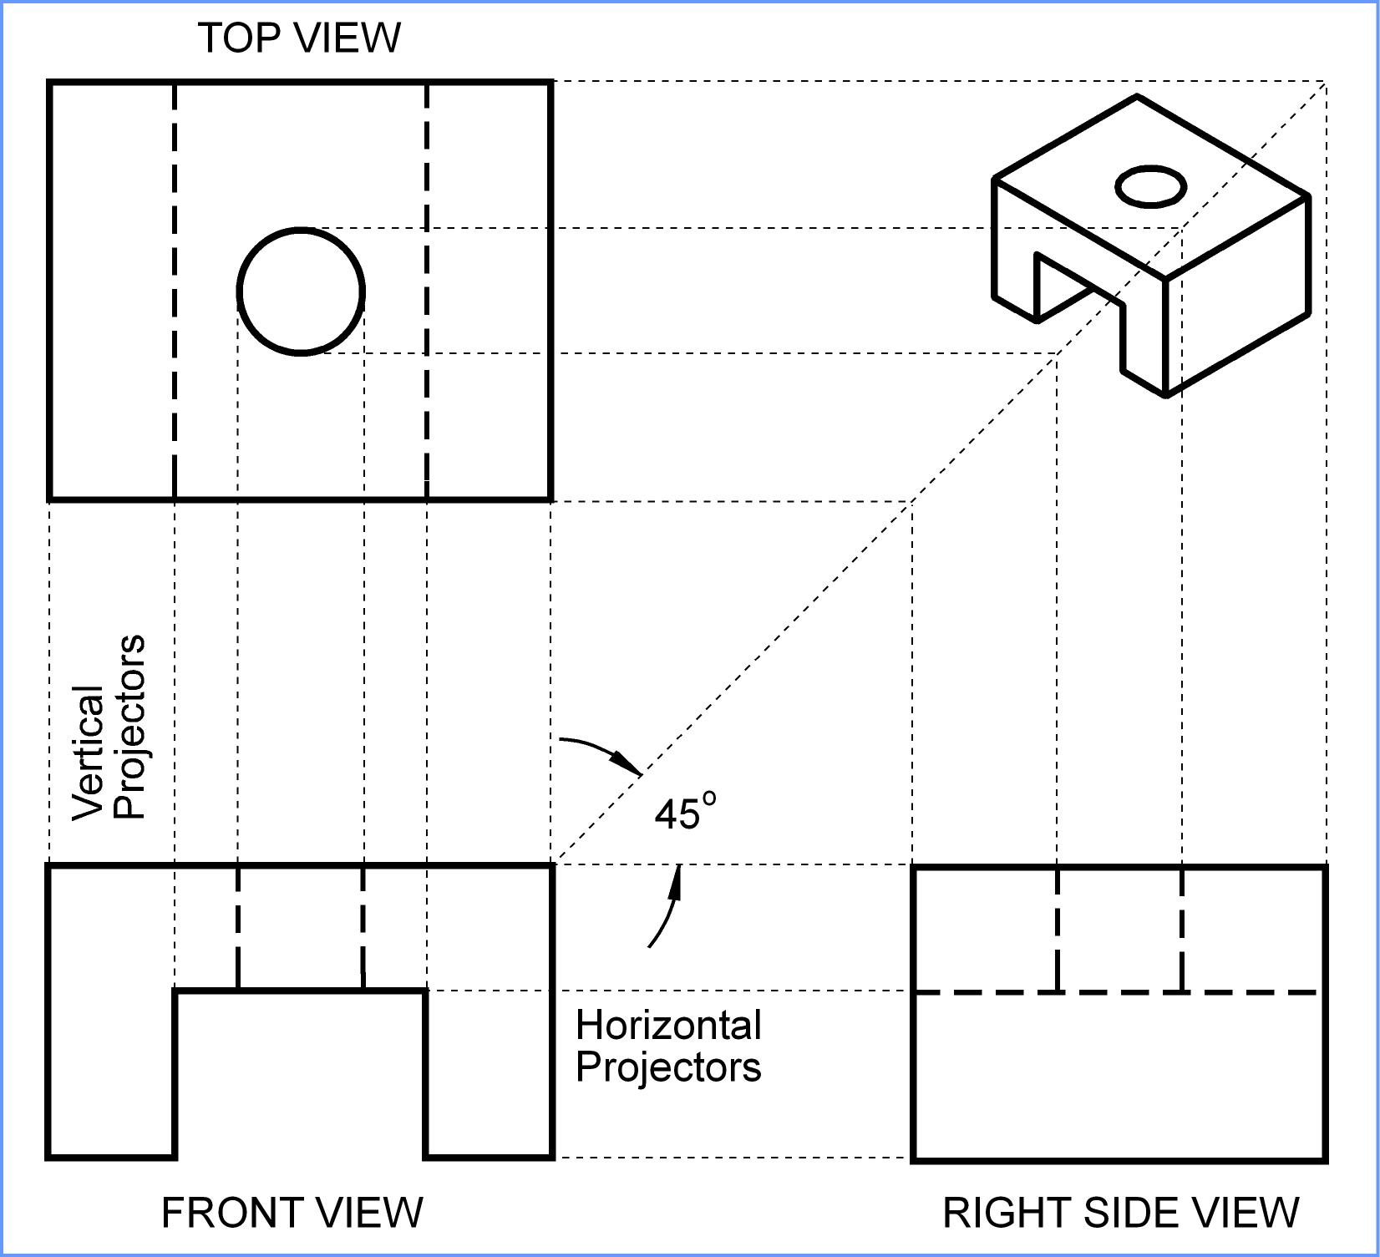
Creating an Orthographic Projection
Draw the right side view.

Slide 104
Creating an Orthographic Projection
Project back if needed.

Slide 105
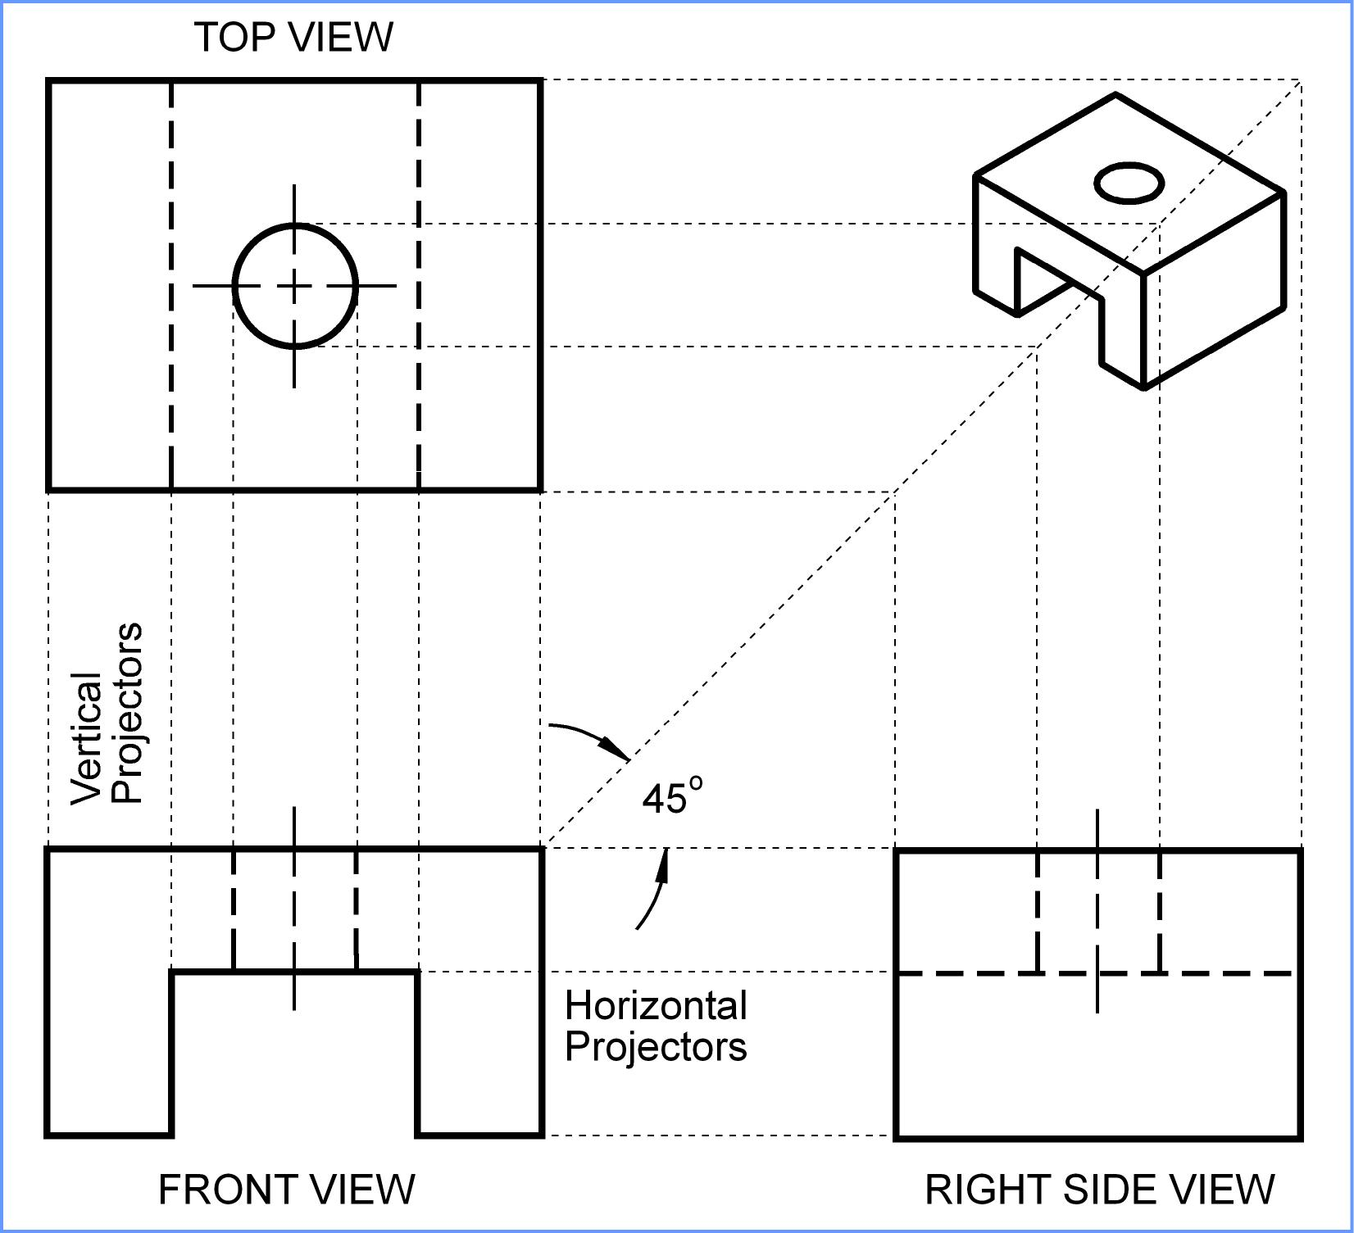
Creating an Orthographic Projection
Draw centerlines where necessary.

Slide 106
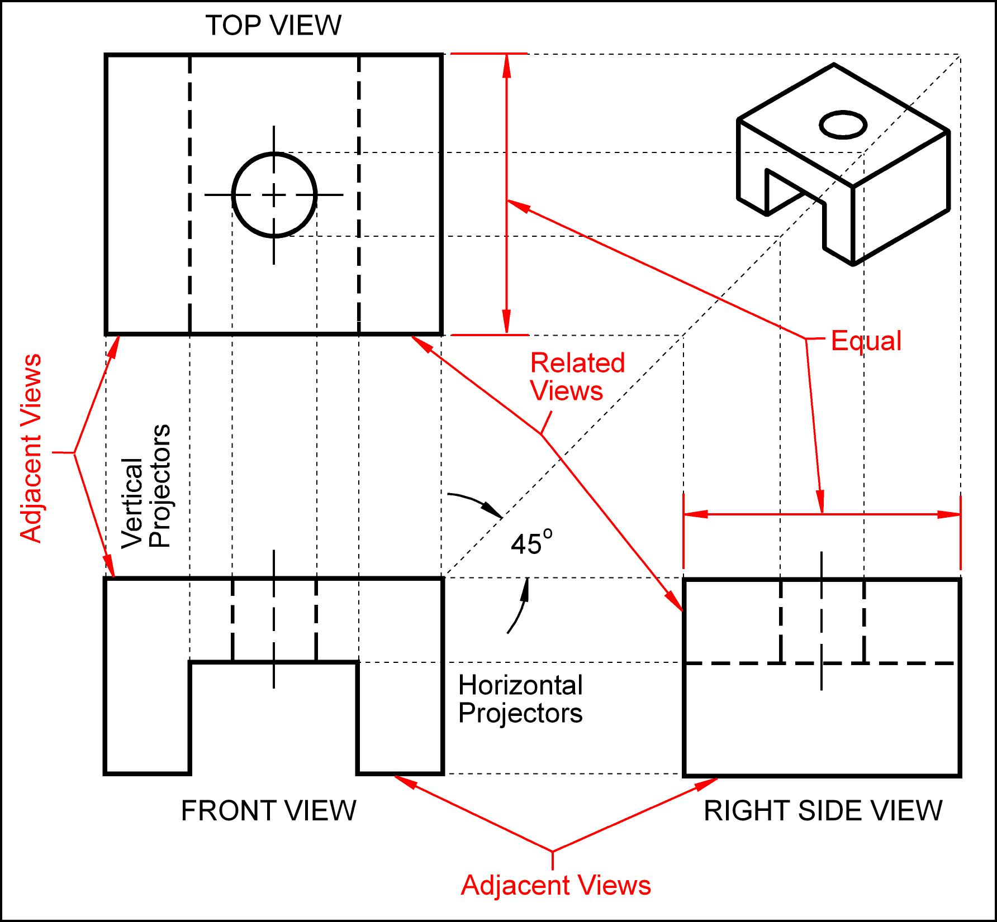
Creating an Orthographic Projection

Slide 107
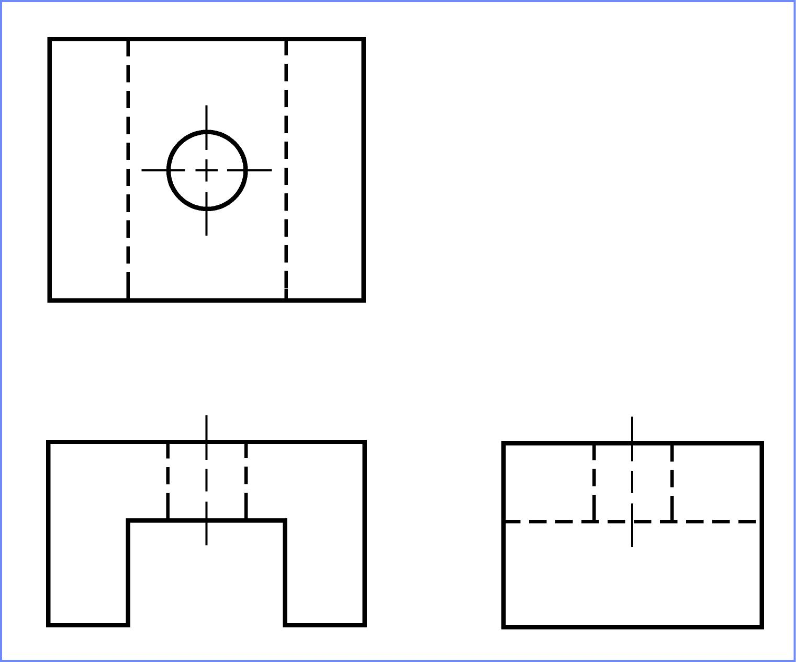
Completed Drawing

Slide 108
Projection Symbol
United States = 3rd angle projection
Europe = 1st angle projection

Slide 109
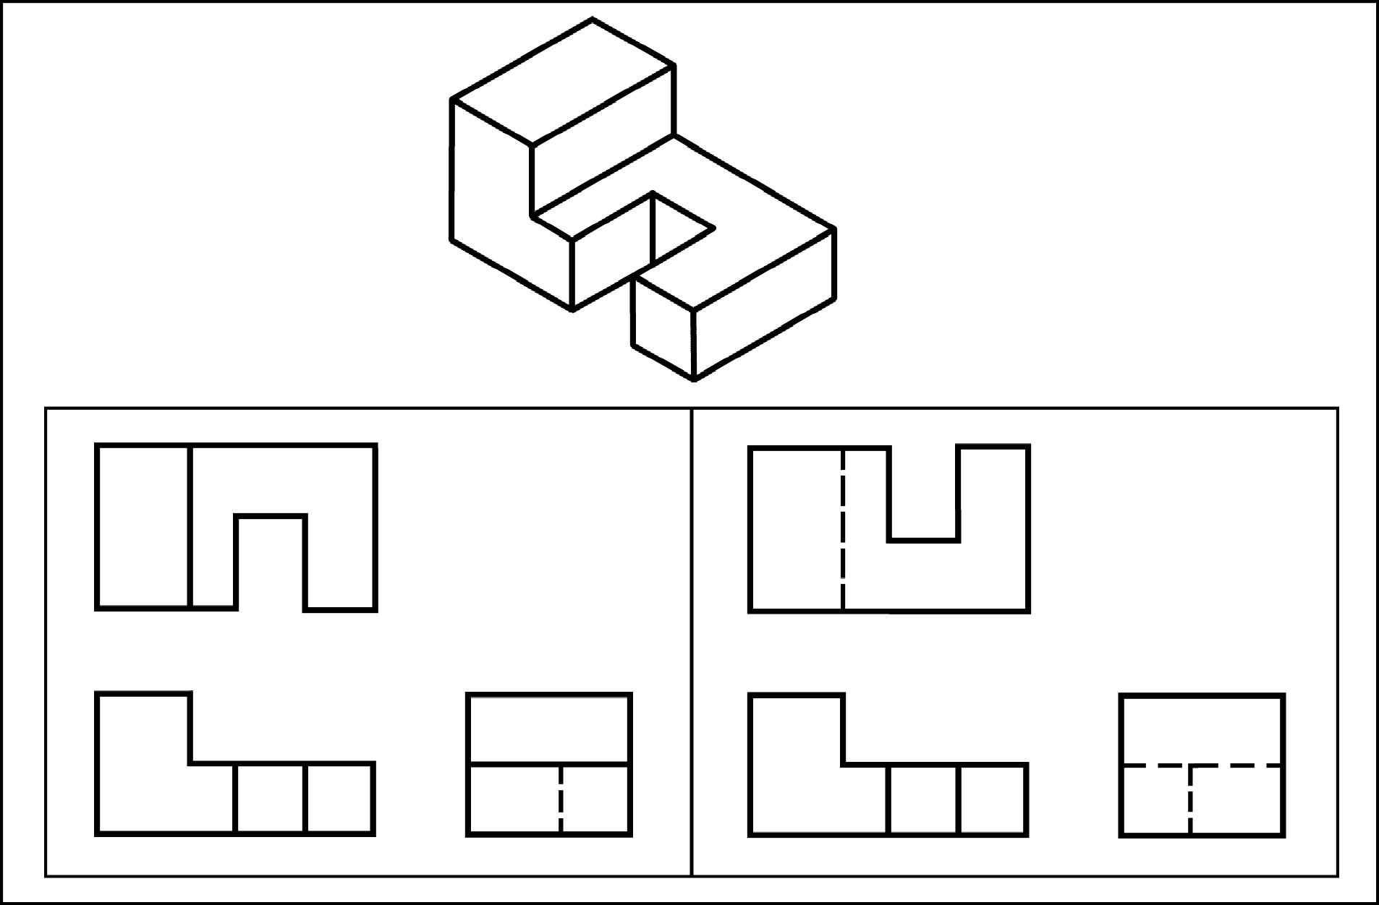
1st Angle & 3rd Angle
Which orthographic projection uses 1st angle projection and which uses 3rd.
3rd Angle
1st Angle

Slide 110
Exercise 1-4
Missing lines 1

Slide 111
Exercise 1-4
Fill in the missing lines in the front, right side, and top views.

Slide 112
1 missing visible line in the front view.

Slide 113
The right side view has 1 missing visible line and 2 missing hidden lines.

Slide 114
The top view has 5 missing visible lines and 2 missing hidden lines.

Slide 116
Exercise 1-5
Missing lines 2

Slide 117
Exercise 1-5
Fill in the missing lines in the top, front, and right side views.

Slide 118
The top view has 1 missing visible line.

Slide 119
The front view has 4 missing visible lines and 4 missing center lines.

Slide 120
The right side view has 2 missing hidden lines and 1 missing center line.

Slide 122
Exercise 1-8
Drawing an orthographic projection 1

Slide 123
Exercise 1-8
Shade in the surfaces that will appear in the front, top, and right side views.
Estimating the distances, draw the front, top, and right side views.
Identify the surfaces with the appropriate letter in the orthographic projection.

Slide 124
1) Shade in the surfaces of the front view.
2) Draw the front view.
3) Identify the surfaces.

Slide 125
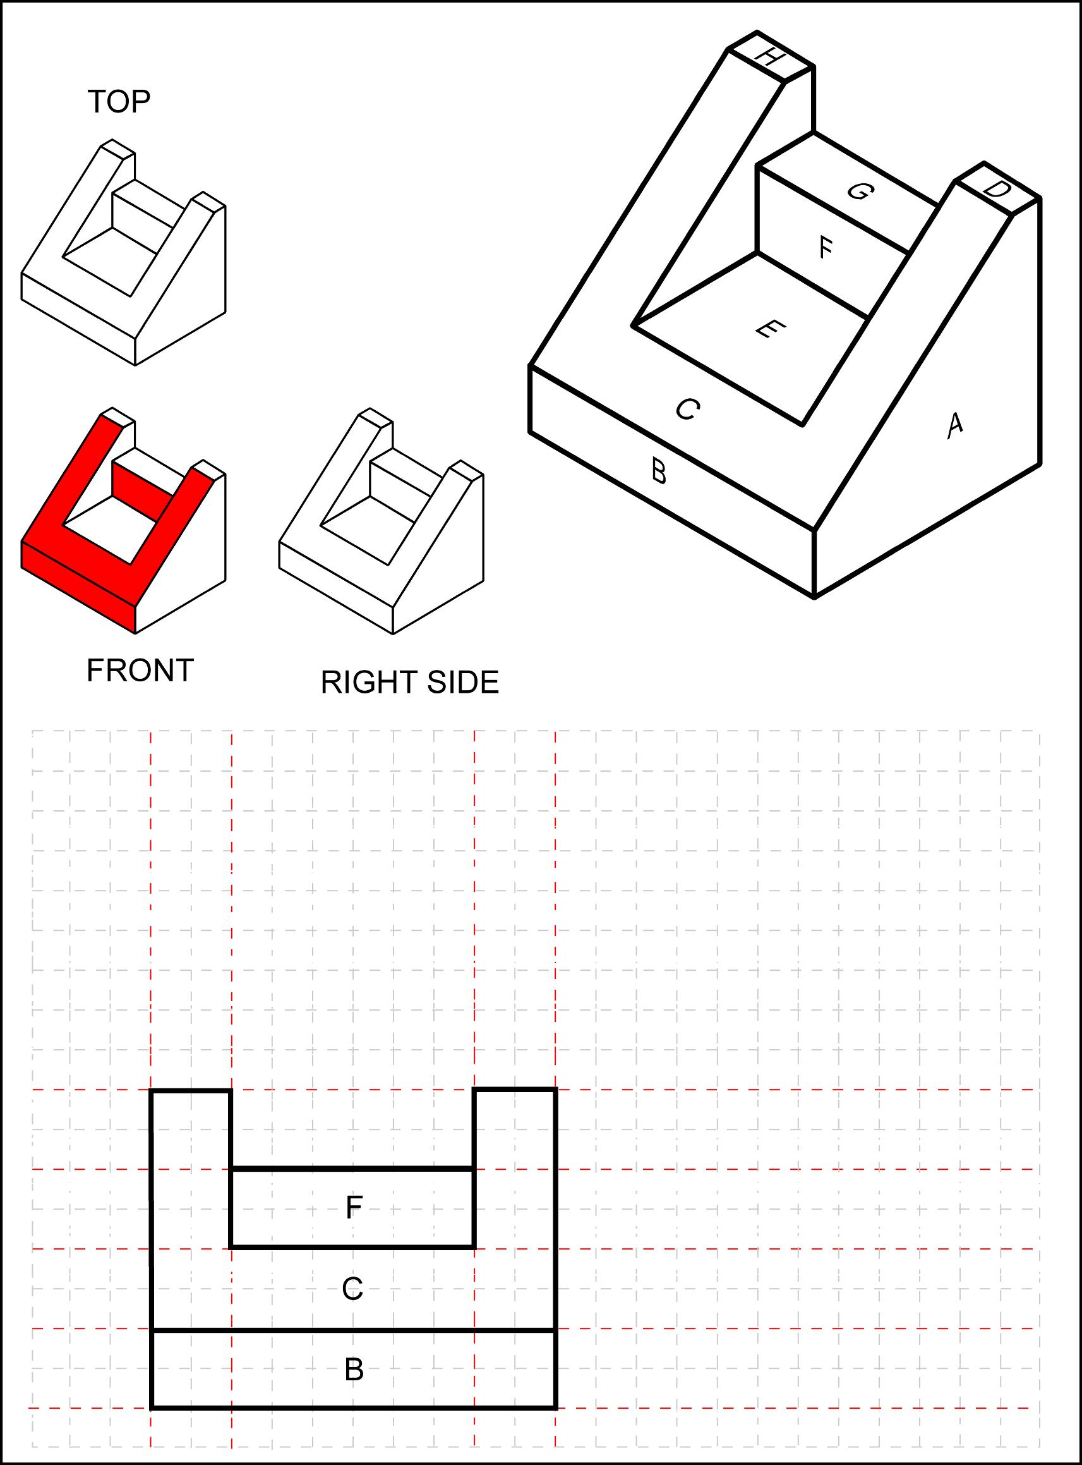
1) Shade in the surfaces of the right side view.
2) Draw the right side view.
3) Identify the surfaces.
Notice the horizontal and vertical projectors.

Slide 126
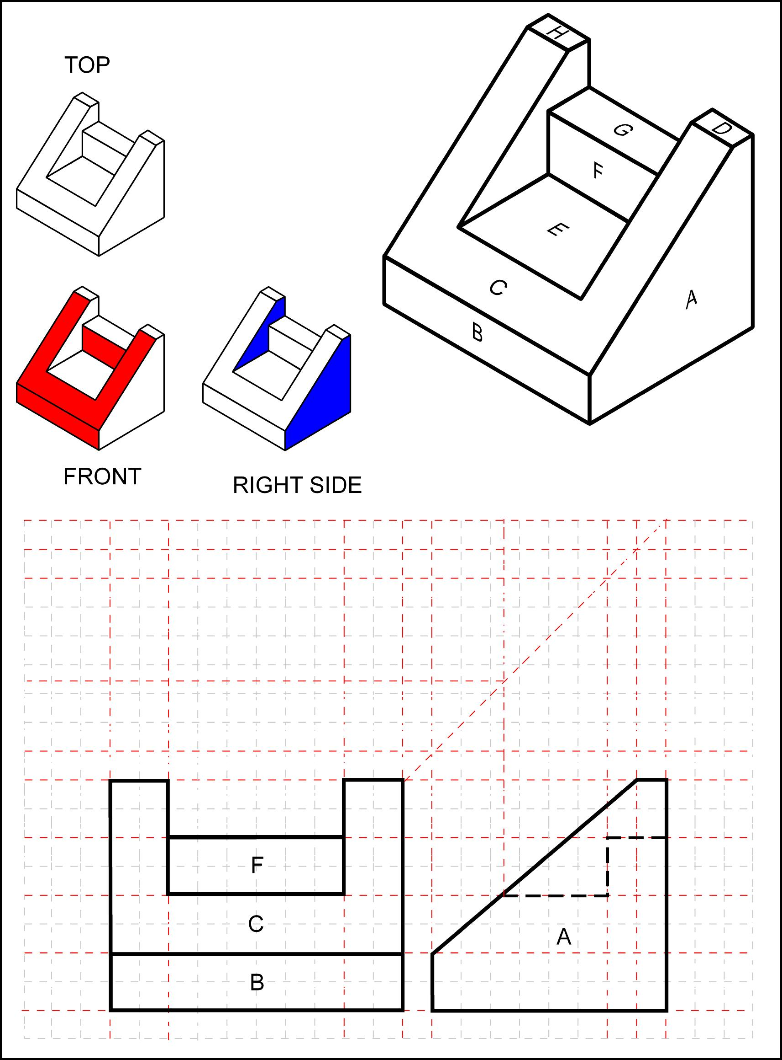
1) Shade in the surfaces of the top view.
2) Draw the top view.
3) Identify the surfaces.
Notice the 45 deg. projector

Slide 127
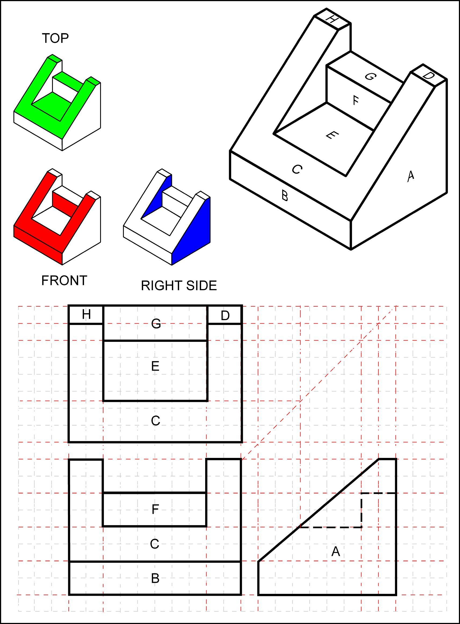

Slide 128
Exercise 1-9
Drawing an orthographic projection 2

Slide 129
Exercise 1-9
Identify the best choice for the front view.
Estimating the distances, draw the front, top, and right side views.
Front view = A

Slide 131
Orthographic Projection
1.8) Auxiliary Views

Slide 132
Auxiliary Views
Skip advanced topic
Auxiliary views are used to show the true shape of features that are not parallel to any of the principle planes of projection.
Aligned with the angled surface
Partial auxiliary view

Slide 133
Exercise 1-12
Auxiliary View

Slide 134
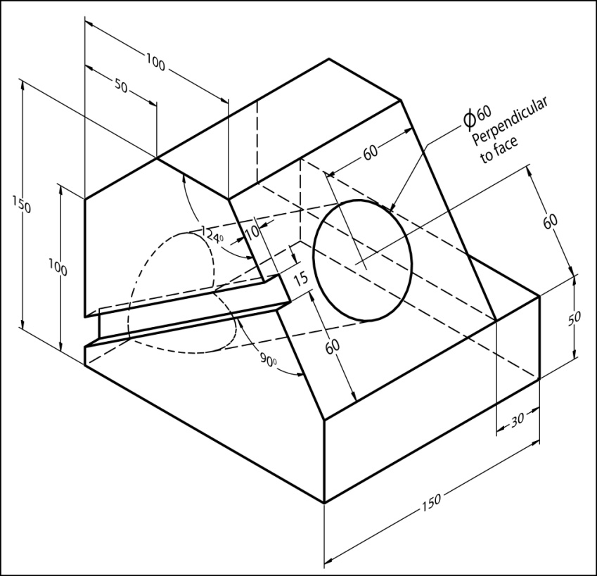
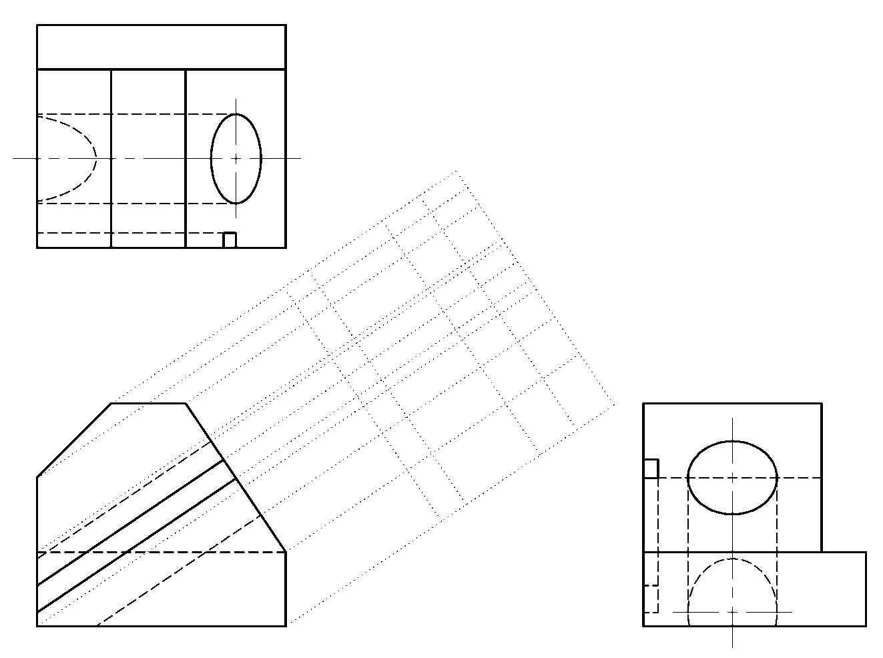
Exercise 1-12
Draw the auxiliary view for this object.

Slide 136
Orthographic Projection
End

